Slide 1
Welcome to our
Parent Forum

Slide 2
What is the parent Forum?
The Parent Forum will be an informal meeting where parents are invited to be consulted on school issues, give their views and raise areas for discussion.

Slide 3
What is the Parent forum not
Parent governors – they sit on the Local Governing Committee and lead the strategic development of the school.
PTA – they are a separate legal entity who are registered as a charity, raising money to support different aspects of the children’s school life.

Slide 4
Terms of Reference….As a member of the parent forum I agree to:
Show respect to all members of this forum, by listening to and respecting a diverse range of opinions
Allowing everyone the opportunity to speak
Stick to agreed timescales for discussion of topics
Maintain confidentiality by not mentioning the names of individual members of the community
Avoid discussing individual circumstances. These issues will be directed via the school’s communication procedure instead

Slide 5
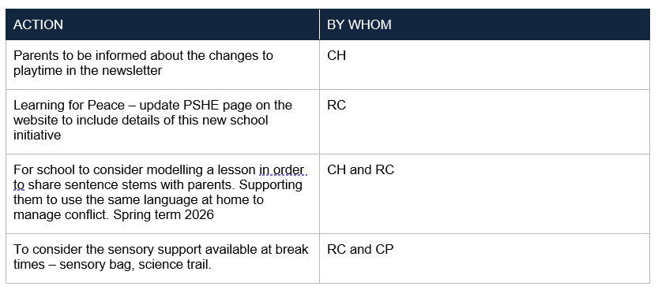
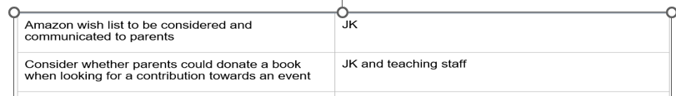

Slide 6
St Joseph’s Pupil Premium Strategy

Slide 7
What is Pupil Premium?
Extra government funding
What is it for?
Improve the educational outcomes of disadvantaged children
Who is eligible for Pupil Premium?
Eligible FSM (past 6 years)
LAC/ PLAC
Armed Forces families (Service PP)
Guidance
Must be spent in evidence informed ways- EEF
Is not a personal budget
Must publish strategy on school website

Slide 8


Slide 9
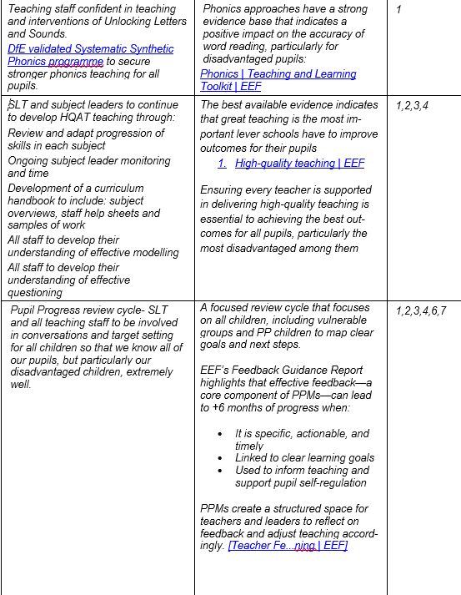
Teaching
Monitoring
CPD- Phonics
HQAT
Learning Walks
Pupil Progress
Targetted Academic Support
Academic Interventions
SEN Interventions
Screening
Well-being Interventions
Wider Strategies
Play Lead
SLT Attendance
Home Visits
Further CPD
Senior Mental Health Lead

Slide 10
The Writing Framework

Slide 11
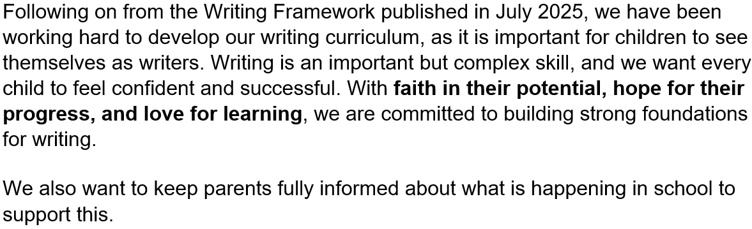

Slide 12
1. Start with the Basics
In Reception, handwriting and spelling should be taught so these skills become automatic. This frees up children’s thinking for creative writing later on.
Teach handwriting explicitly and regularly – daily EYFS and KS1 Use a structured scheme (ULS) with agreed fonts for early letter formation Ensure children develop correct grip, posture, and formation habits Provide consistent expectations and teacher modelling across the school – Hue visualisers used

Slide 13
2. Build Strong Sentences
All writing is made up of sentences. Children should learn how to construct clear, meaningful sentences before moving on to longer pieces.
Accurate transcription skills (handwriting + spelling) – ULS scheme Teach clear, accurate, coherent writing as a whole‑school expectation – clear writing process across the school Language‑rich learning and strong oracy foundations – Talking Through Stories English teaching within Reception that builds from early sentence formation - ‘Super Sentences’ – the opportunity to write simple sentences linked to phonics. We use: shared writing to model sentences, sentence stems and starters, adult scaffolding to help children move from words – phases and sentences.

Slide 14
3. Talk Before Writing
Speaking and listening are just as important as writing. Children should plan and practise ideas aloud before putting them on paper.
Build speaking and listening into every part of the curriculum Prioritise Communication & Language throughout EYFS Create classrooms rich in talk, questioning, and discussion Uses storytelling, assemblies, drama, debates, and peer dialogue to rehearse ideas aloud - Think Pair Share and Cold Calling used. Encourage children to articulate, explain, and discuss before they write Look Who’s Talking competition to promote oracy across the school

Slide 15
4. Quality Over Quantity
Long pieces of writing should not be expected too soon. First, children need to master the foundations—handwriting, spelling, and sentence building.
Place high importance on transcription (handwriting, letter formation, spelling) Teach handwriting explicitly and progressively Develop sentence-level skills before expecting extended writing Create a language-rich EYFS where early writing foundations are built slowly and securely

Slide 16
5. Reception is Key
The Reception year lays the groundwork for writing success throughout primary school.
Build strong foundations through a purposeful, well-sequenced EYFS Prioritise communication and language development Develop fine motor skills, early writing behaviours, and phonics Embed talk and oracy as essential precursors to writing

Slide 17
6. Extra Support When Needed
If a child needs more help, this should be identified early and extra time and practice provided to help them make good progress.
Build strong communication, listening, and language skills that highlight early difficulties Monitor handwriting and transcription closely and addressing errors immediately Interventions to ensure that children keep up not catch up Refer children to the SENDCO when necessary (if challenges are persistent or more complex) using our schools systems.

Slide 18
7. Step-by-Step Progress
Writing takes time to learn. The essentials should be taught first, and more complex skills introduced gradually.
Use a well-sequenced EYFS curriculum that builds skills layer by layer Teach handwriting with a clear progression path from simple to more complex – ULS scheme Strengthen communication, vocabulary, and sentence skills before extended writing – retells, shared writing Develop English skills progressively across Reception to Year 6 Provide extra support early so children master essentials before moving on

Slide 19
8. Focus on Learning, Not Just Tests
Too much test practice can limit creativity. The focus should be on developing confidence and skill in writing.
Meaningful learning experiences, not repetitive test practice – work linked to their interests and current ideas. Oracy and communication, which boost creativity, clarity, and confidence Strong foundational teaching in EYFS Progressive skill-building rather than pressure Supportive, responsive intervention often 1:1 lower down the school

Slide 20
9. A Positive Writing Culture
Writing should be valued across the school, teachers well-trained, and the curriculum carefully planned.
Prioritise high-quality writing across the whole school using a well-planned, sequenced curriculum beginning in EYFS Ensure teachers are skilled in developing oracy, handwriting, and writing Setting and upholding high expectations for presentation – REACH values Encourage creativity, expression, and confidence in writing Children’s work is often celebrated on displays; in assemblies; and with SLT and the English lead.

Slide 21
Other topics that you would like to discuss?

