Slide 1
REACH
Year 6 Awards
July 2020

Slide 2
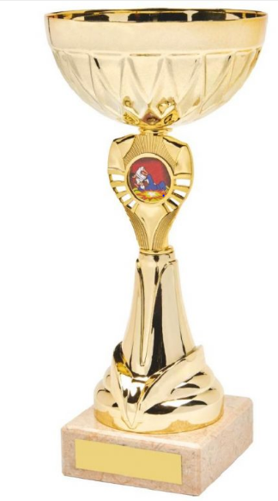
Wesley Chaplin Cup for Sports
Leo Tiley

Slide 3
Danby Trophy for Citizenship
Holly Stewart

Slide 4
Gregory Award for Music
Matilda Williams

Slide 5
Art Award
Ruby Dickinson

Slide 6
Marion Mills award for Dance
Emilia Spencer

Slide 7
Mrs D’Arcy’s Chaplaincy Award
Lily Tarr

Slide 8
Reading Award
Key Stage 1
Key Stage 2
Willow Carter-Smith

Slide 9
Mathematics Award
Key Stage 1
Key Stage 2
Layla Pegler-Smith

Slide 10
Congratulations to you all!

