Slide 1
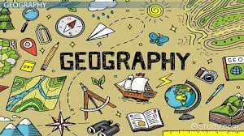
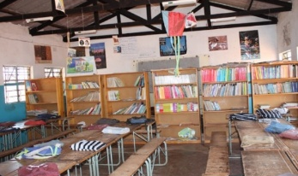

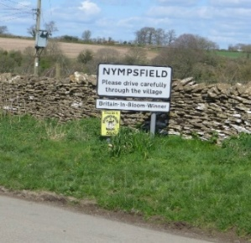

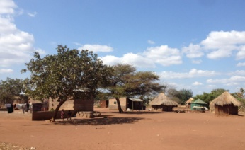
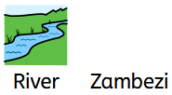
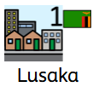





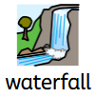

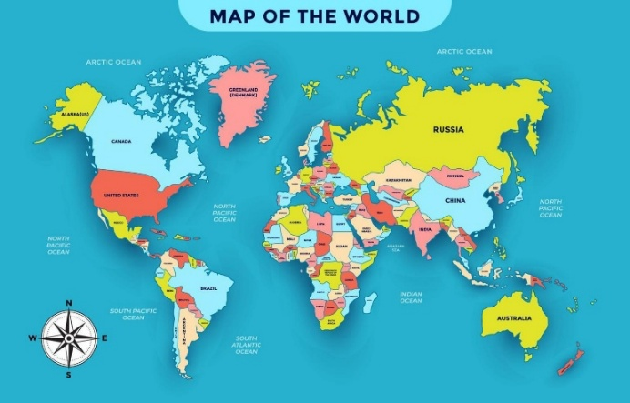
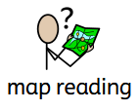

Topic: Nympsfield vs Zambia | Year Two
Vocabulary
 | A large continent made up of many countries.
 | A country in Africa known for its beautiful landscapes and famous waterfalls.
One of Africa’s longest rivers. It flows through Zambla.
 | The capital city of Zambia. It is a busy place where many people live, work, and go to school.
 | A crop is a plant that farmers grow for food, like maize, rice, or vegetables.
 | A place where people grow crops or keep animals such as cows, goats, or chickens.
 | Animals that live in the wild, such as elephants, lions, zebras, and giraffes.
 | A flood happens when too much rain causes rivers or lakes to overflow, covering the land with water.
A market is where people buy and sell fruit, vegetables, clothes, and crafts.
 | A waterfall is where water flows over the edge of a high place.Victoria Falls in Zambia is one of the biggest and most famous waterfalls in the world.
Sticky Knowledge
Zambia is a country in southern Africa.
Zambia has a tropical climate, so it’s warm for most of the year. There is a dry season and a wet season.
There are many national parks in Zambia where the government protects the land and its special wildlife.
Mugurameno is a village in rural Zambia.
Nympsfield is set in the south Cotswolds in the county of Gloucestershire.
Skills I will use
 | Observing I can observe similarities and differences between Zambia and Nympsfield.
 | Map reading I can use a map to understand where Africa is in the world.
 | Classifying I can correctly identify physical and human features of Zambia.

