Slide 1



Reading at St Joseph’s
Reading Gives You Wings...
June 2025

Slide 2

What does Reading look like at St Joseph's Catholic Primary School?
Reading gives you wings …
Children have daily reading sessions in class.
Many children read one-to-one with adults and we are very lucky to have a team of volunteers (parents and governors) and support from local charities such as Read With Me and Pets as Therapy

Slide 3
From the start…
ULS (Unlocking Letters and Sounds)
All schools had to choose an SSP (Systematic Synthetic Phonics).
ULS is a fully resourced and DfE validated and approved SSP

Slide 4
From the start…
ULS (Unlocking Letters and Sounds)
Resources totally matched to the programme
Children take home 2 books – one matched to their phonological stage and one high quality text
Children are asked to read their phonologically matched book 3 times
Once children have completed the phonics program (usually by Easter in Year 1) they will move on to our levelled Big Cat books
1:1 interventions

Slide 5
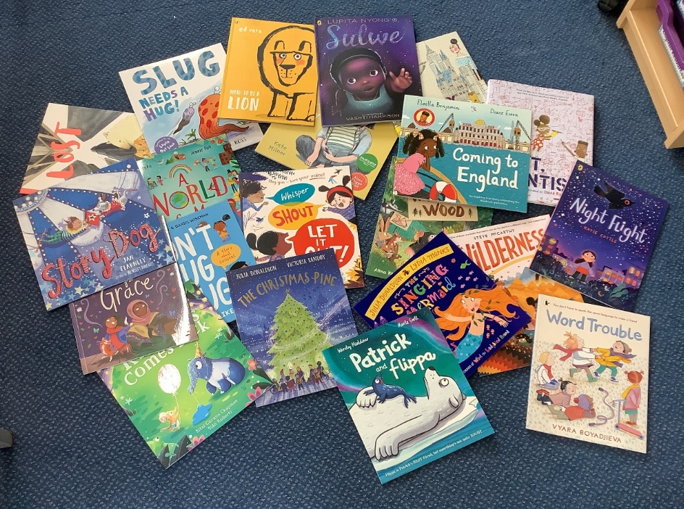
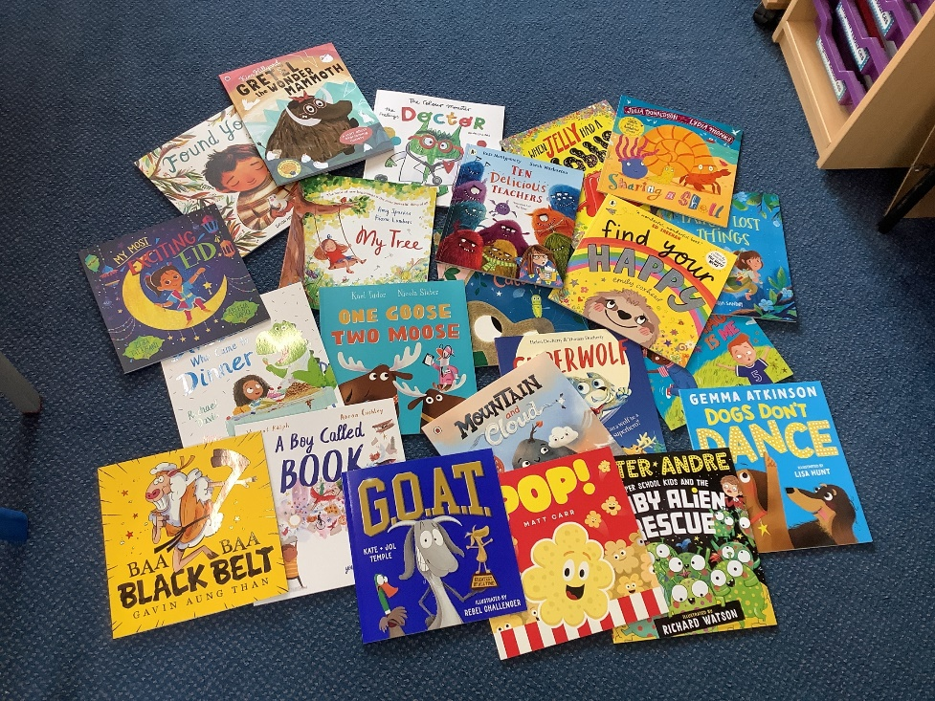
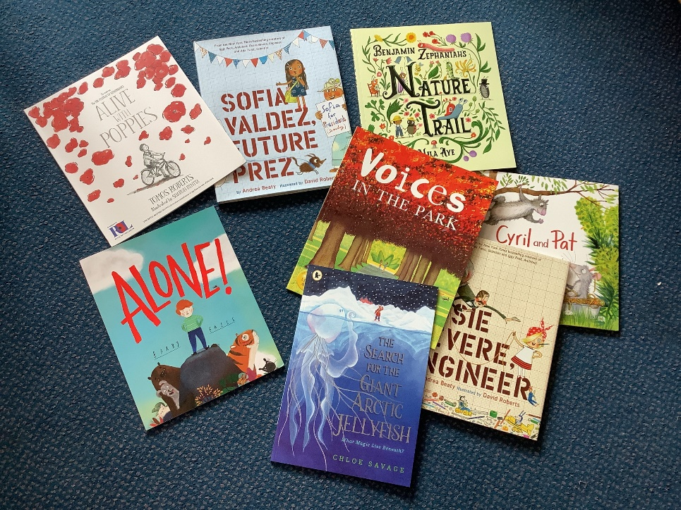
New high quality texts bought with Scholastic rewards in May 2025

Slide 6
Big Cat reading scheme
Introduced March 2022.
Pupil voice - conferenced the children to ask what they wanted.
The Big Cat reading scheme uses the book band system of progression with even finer steps in KS2.
  Structured and engaging approach to reading development.
  Utilizes a dual-banded system and carefully levelled books to match both reading ability and age-appropriate interests.
  Helps build reading fluency, stamina, and confidence while introducing a variety of text types and genres.

Slide 7
Key Stage 2
Children take home 2 books. One from our Big Cat reading scheme and a high quality other text…
Book changing:
Big Cat book should be changed once a week/or when finished.
Novel/other text can be changed when the child has finished it.

Slide 8
Reading Rewards…
Recently we clarified how the reading points work with parents and staff .
Points are awarded for as follows:
5 reads in 1 week
If a child reads daily (ie 7 times in a calendar week) - the points will continued to be counted and rolled on.
1 ‘read’ will be awarded per day of reading (If a child reads 3 times in 1 day this counts as 1 read)
Reading points over school breaks will be counted – except for the summer holidays when the diaries are collected in
Children from R to Year 4 are expected to read school books
In Year 5/6, children’s teachers will discuss with them, when appropriate, whether they are able to read books from home instead of school books.

Slide 9
Reading culture
At our school, reading is woven into the fabric of daily life
Book corners
Regular events
Reading club
Reading Ambassadors
Daily story time
Through faith, hope, and love, our commitment to reading is more than a program — it is a cornerstone of our school’s identity and a joy shared by our whole community.

