Slide 1
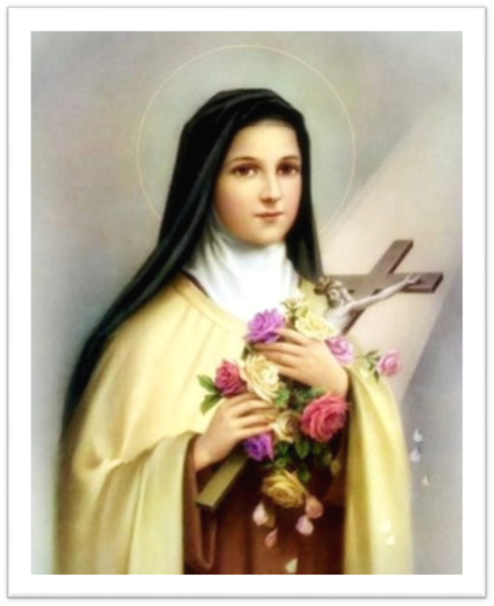
The Little Way Catholic Educational Trust
Consultation Event
Wednesday 25th January 2023
Notes:
Chair of Governor/Head Teacher
Introduce the people on the call/in school, they will give a short explanation of their role (Diocese, Head Teacher and all governors in attendance)
House keeping – questions to be put into the chat/ or, there will be an opportunity to ask questions at the end.
Any questions asked will feed into the FAQ
The presentation will be available on your school website

Slide 2
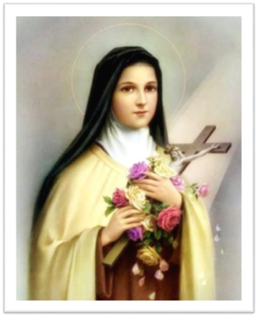
Event Aim and Objectives
Aim: to inform parent/carers and other stakeholders about the governing body’s proposal and consultation process
Objectives:
Explain why the Governing Body is conducting a consultation
Outline the role of the Diocese, its vision, strategy and timeline
Describe the proposed vision for our Catholic MAT and what we see as the benefits for our school
Clarify what would change and what would stay the same
How to respond to the consultation process
Notes:
Chair of Governors/Head Teacher

Slide 3
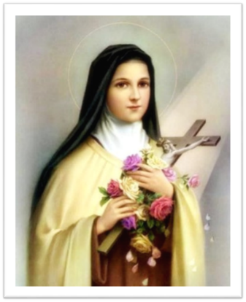
The Bishop’s Vision
In 2016 and again in 2019, Bishop Declan shared his vision for all his schools to work together and undertake a due diligence exercise in readiness for the establishment of Catholic Multi Academy Trusts (MATs) across the diocese.
His reason for doing this was to respond to the changes in the educational landscape and “ensure Catholic education is sustainable and remains true to its key principles for the generations of pupils now and yet to come”.
Notes:
DIOCESE TO PRESENT/Chair of Governors/Head Teacher
What is the Role of the Diocese?
Canon Law (Church Law) provides that each Diocesan bishop has strategic responsibility to commission sufficient school places to meet the needs of baptised Catholic Children in this area. A Catholic school is one which is recognised as such by the Diocesan bishop. In respect of his schools, which includes academies the bishop has the legal right to appoint (and remove) an overall majority of directors and governors. In addition to all the other legal responsibilities, the law recognises that foundation directors and governors are appointed specifically to ensure:
That the Catholic character of the school is preserved.
That the school is conducted in accordance with its trust deed.
That the religious education curriculum is in accordance with the bishop’s policy for the Diocese.
The Diocesan bishop, acting through his Director of Schools and Colleges is responsible for:
The provision and future development of excellent Catholic education throughout the Diocese.
The oversight of high educational standards, progress, and outcomes in all Diocesan schools
The appointment, development and training of foundation directors and governors and their removal.
The inspection of religious life of schools and RE (Section 48 inspections)
The development of Catholic teachers and leaders (and all appointments should be made with diocesan protocol)
The oversight of school buildings/ estate and capital projects
Planning of school place provision
Engaging with the Local Authority (LA), Regional School Commissioner (RSC) and Ofsted
Maintaining links with the Catholic Education Service and appropriate government departments

Slide 4
Why Now?
Catholic education imperative - collective responsibility for all children in Catholic schools and develop Catholic leaders
Improvement imperative - urgent need to maintain and build on the strengths of good Catholic schools and provide support to Catholic schools with a directive Academy Order or who are vulnerable.
Financial imperative – schools under intense pressure with budgets. The MAT application must demonstrate financial sustainability from Day One. Opportunities, over time, to pool resources which may lead to cost efficiencies. Bid for additional grant funding only available to academies, for set up, school improvement and leadership capacity.
Notes:
DIOCESE TO PRESENT/Chair of Governors/Head Teacher
Academy status provides access to additional capital grants
Six FGs instead of seven to recruit for LGCs. Total 10 governors instead of 12. For many schools it has been a challenge to recruit enough governors.
Less duplication re need for regulatory compliance, reporting/submissions
Diocese investment in PK and external consultants to provide additional and expert capacity throughout the process
Converter academies receive a grant of £25k towards the cost of the academy conversion e.g. legal fees.

Slide 5
Our Proposal
To apply to convert to academy status and
join The Little Way Catholic Educational Trust on
the target opening date of 1st September 2023
Notes:
CHAIR/Head Teacher
To read out the slide
First step is to apply for consent from the Diocesan Academy Board in February to become part of a MAT followed by an application to the Regional Schools Commissioner, planned in March.

Slide 6
Our Vision
Kindness is my only guiding star. In its light, I sail a straight route, I have my motto written on
my sail: 'To live in love.' St Therese of Lisieux.
Our Trust family is united in its shared mission to develop our Catholic ethos in order to transform the lives of every child, family and community we serve, in Jesus’ name.
Our vision is to empower every child to excel academically, socially, morally, culturally and spiritually in order that they may flourish as individuals. Assured of the love of God, we strive to educate children within an inclusive and compassionate community which celebrates the gifts and talents of our pupils and removes barriers to learning. We strive to be a community of life-long learners, contributing to a just and loving society.
Our Trust family is a partnership of equals who work collaboratively so that everyone can grow and learn together. We celebrate the diversity of our schools, retaining our individual characteristics, whilst working together for the greater good of our whole community.
Through honesty, respect, service and solidarity we value each other as one family.
All are welcome.
Notes:
Every school was involved in developing Our Vision for the MAT through working together in the Partnership Mission & Ethos committee.

Slide 7
The Schools Involved
The Little Way
Catholic Educational Trust
Notes:
Heads

Slide 8
Benefits for all our Children
Improve the quality of education for all pupils in all areas of the curriculum and wider curriculum – an equal offer for all children in our Catholic schools within the MAT
Increased opportunities for pupils to learn from expert teachers and specialist staff
Improved shared access to resources and provision of specialist skills
Headteachers to focus on quality of teaching and learning, ensuring all children are ready to learn, make progress and achieve
Pupils would benefit from schools who work more efficiently to create cost savings and bid for additional funding grants only available to academies
Pupils would benefit from shared enrichment and extra-curricular activities
Notes:
HEADTEACHER
Delivering education improvements is at the centre of this proposal. Our proposed MAT would have as its driving imperative the provision of trust wide school improvement strategies backed by access to greater resources which would improve the academic and Catholic education standards and lead to accelerated and sustained improvement. Our children should receive an equal offer whichever of our school’s they’re in, able to avail of the skills and specialisms of all of our schools.
These staff could innovate, share knowledge, and best practice across our family of Catholic schools.
Pupils would benefit from the cost savings created through bulk buying power which could be used to improve resources and provide specialist support which may not be affordable for a single standalone school e.g., speech and language therapist, sensory play equipment, IT technician support.
Headteachers would lead the day-to-day running of their school as they do now but with more freedom for senior leaders, including governors, to focus on improving the quality of education and related matters (e.g., wellbeing and attendance) that help to ensure all children are ready to learn, make progress and achieve.
Similarly, pupils would benefit from being served by schools who can bid for additional funding grants only available to academies. For example, building MAT capacity releases headteachers to focus more of their time on driving school improvement.
These would become affordable when more children participate and promote inter-academy friendships e.g., trips and sports matches.

Slide 9
Main Benefits for all our Staff
Increased collaboration to support each other
New leadership and career opportunities
Increased job security for all staff
Avoid duplication of work for leaders
Notes:
HEADTEACHER
Being part of a larger organisation provides more opportunities to work collaboratively, share best practice and support each other. The Partnership schools have been working collaboratively for a number of years and being part of a MAT provides an opportunity to build on that further.
Equally, being in a family of schools opens up opportunities to develop for leadership roles within the MAT and in shared resource roles
As an employee of a MAT family of schools opens up more opportunities to existing staff
MAT will have more Trust wide systems, policies and shared resources eg finance, management information, estates, H&S, HR etc freeing up leaders to focus on education standards, school improvement and relationships with their local community.

Slide 10
What Would Change?
The legal status of the school i.e., from a single local authority maintained school [or single academy school] to being part of a family or group of academy schools known as a Multi-Academy Trust (MAT).
The MAT would receive its funding directly from the Department for Education and allocate it to its academy schools.
All staff wherever they are based would be employed by the MAT, not an individual governing body, but would remain based in their existing school.
Oversight by a single Trust Governing Board responsible for the educational and financial performance of all schools and compliance with statutory duties. The Trust Board would establish committees, including Local Governing Committees.
Notes:
HEADTEACHER
Read through the points – have the FAQ to hand in case any questions arise about the negatives of joining a MAT

Slide 11
What Will NOT Change?
Catholic ethos and values
School identities
School names
School uniforms
Day-to-day school leadership
School staffing
Notes:
Head Teacher

Slide 12
MAT Governance Structure
Members
Board of Directors
Local Governing Committee
Trust Finance, Audit & Resources Committee
Trust Standards & Performance Committee
Local Governing Committee
Local Governing Committee
Local Governing Committee
Local Governing Committee
Local Governing Committee
Apply to become a director or local governor via: Leadership & Governance | Clifton Diocese Schools and Colleges
Notes:
Diocese or Chair of Governors
Core Functions of Governance:
Foundation Governors to implement the Bishop’s vision as his representative;
Ensuring clarity of vision, ethos and strategic direction;
Holding executive leaders to account for the education performance of the organisation and its pupils, and the effective and efficient performance management of staff; and
Overseeing the financial performance of the organisation and making sure its money is well spent
Members have a trust wide role. They are all Diocesan appointed representatives and meet formally once a year at the AGM. They protect the core purpose of a Catholic MAT
The Members appoint most directors as foundation directors. The Board of Directors holds ultimate responsibility for the educational and financial performance of the MAT (incl. all its schools). They are held accountable by the Members and Department for Education.
Trust committees have a trust wide oversight role.
The remit for Local Governing Committees would be to focus on holding their school’s headteacher to account for the quality of education, pupil outcomes, wellbeing, spirituality and attendance, community engagement.

Slide 13
Consultation Timeline
9th January 2023
6th February
6th Feb to 9th Feb
23rd Jan – 27th Jan
w/b 13th February
Consultation documents, including frequently asked questions and the role of the Diocese
were sent out to parents and wider stakeholders​ & published on school websites.
Stakeholder consultation meetings, including parents/carers, staff, parishes and the wider community. Pupil consultation events in school.
Consultation ends.
School Governing Bodies evaluate the responses from the consultation exercises plus the due diligence process and make the decision about the proposal to join the MAT .
Diocesan Academy Board meet to consider conditional consent for conversions.
Formal Application submitted to DfE with a view to conversion to a MAT for 1st September 2023
Notes:
Chair to read through the slide

Slide 14
How to Respond to the Consultation
Please submit your responses to the questionnaire by 12 noon Monday 6th February 2023.
The questionnaire was part of the consultation letter sent home. A copy of it has been published on each of the school’s website on the Little Way Partnership Section if you wish to download, complete and e-mail to the school.
Hardcopies of the questionnaire are available from the school office.
Notes:
CHAIR

Slide 15
Any Questions? .
Thank you for your time and interest in our consultation process. Please complete the online questionnaire by 12 noon Monday 6th February.
Notes:
Chair – to read out questions from the chat /and indicate people with their hands up.

