Slide 1
SEND Information Morning
Tuesday 6th May
Mrs Chloe Ponting- SENDCo

Slide 2
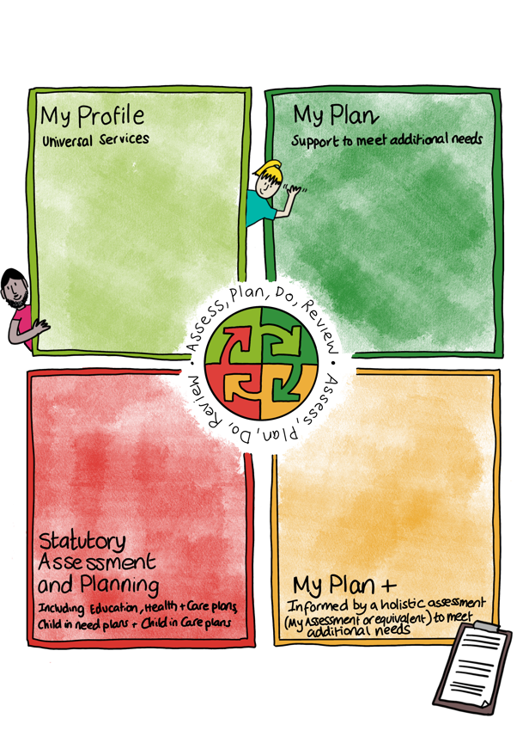
SEND Provision- Graduated Pathway
What is the Graduated Pathway?

Slide 3
SEND Provision- Graduated Pathway
Our Universal Offer:
Essential for some- harmful to none
High Quality Teaching
Calm quiet classroom
Interventions
Sensory Diet
Executive Functioning Development
EYFS Speech and Language Screening
Wellbeing clubs
Technology
Widget
Dyslexia friendly classrooms
PACE
Teachers Available on playground daily

Slide 4
SEND Provision- Graduated Pathway
Support beyond the Universal Offer:
My Plan- specific support reviewed x3
My Plan+- specific support reviewed x3, with the involvement of other agencies.
EHCP (Education Health and Care Plan)-
a multi agency approach for more complex needs x1 Annual Review & My Plan+

Slide 5
SEND Provision- Graduated Pathway
What do I do if I think my child has SEN?
Speak to your child’s class teacher
Teacher will then discuss with SENDCo
SENDCo may observe your child
We will then decide whether your child needs additional SEND support, beyond our universal offer.
Depending on support needed, your child may be added to the SEND register.
Support is based on need not diagnosis.
WT ARE is not SEND.

Slide 6
SEND Provision- Graduated Pathway
How does the school know if my child needs SEND support?
Staff are aware of SEND and monitor progress academically and socially.
Teachers meet with Head Teacher and SENDCo x3 to identify students not making expected progress (teachers can raise concerns at any time)
There is still little or no progress following support.
SENDCo will observe your child to identify strengths and difficulties.
Any concerns will be communicated with you.
Your child may be added to the SEND register.
Referrals to other agencies may be made, with your consent

Slide 7
Wellbeing
Everyone- not just SEND.
Provision at St Josephs:
Well-being lunchtime clubs
Pastoral support for all students
Raising awareness through PSHE and assemblies.
Worry boxes
Mental Health Questionnaires
Signposted support through other agencies
Pupil voice and feedback
Time out cards
Busy Brain Breaks
Reduced timetable

