Slide 1
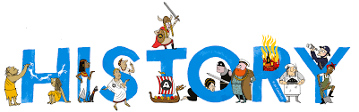
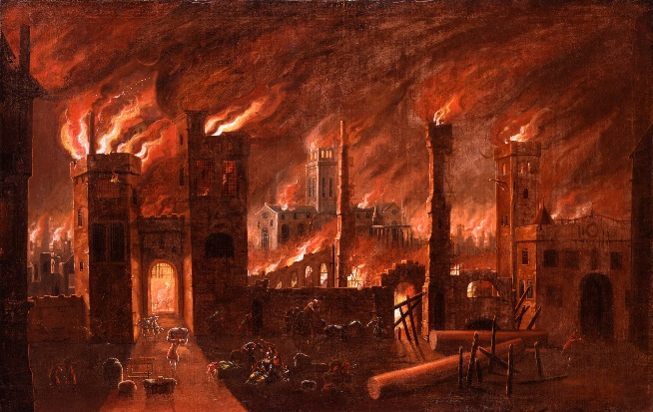








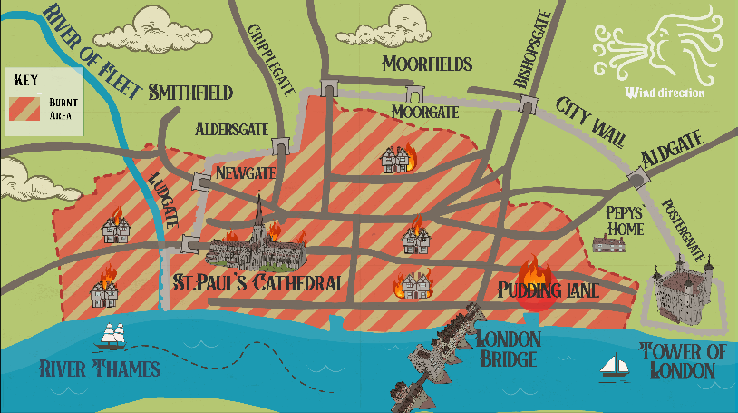

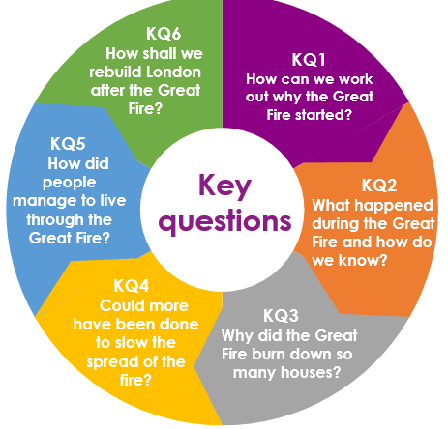

Topic: The Great Fire of London | Year Two
Vocabulary
 | A very large church.
 | A book in which people write about things that happen in their life.
Clues used to prove that something happened.
 | Thick, black sticky liquid that easily catches fire.
 | Writing to remember where something happened in the past.
 | Old-fashioned water carrier. When you push the handle, water squirts out.
 | Straw used to cover roofs. It easily catches fire.
 | A large storehouse.
Sticky Knowledge
The fire started in London in 1666.
The fire began in a bakery on Pudding Lane.
Samuel Pepys wrote a diary that helps us to know what happened.
The fire spread quickly because the houses were wooden and close together.
London was rebuilt using brick to make it safer.
People used buckets, fire hooks and gunpowder to stop the fire from spreading.
Skills I will use
 | Observing I can observe what happened in the Great Fire of London over time.
 | Evidence gathering I can use evidence found from the fire to try and work out what happened.
 | Enquiry I can ask and answer questions about the key events.

