Slide 1
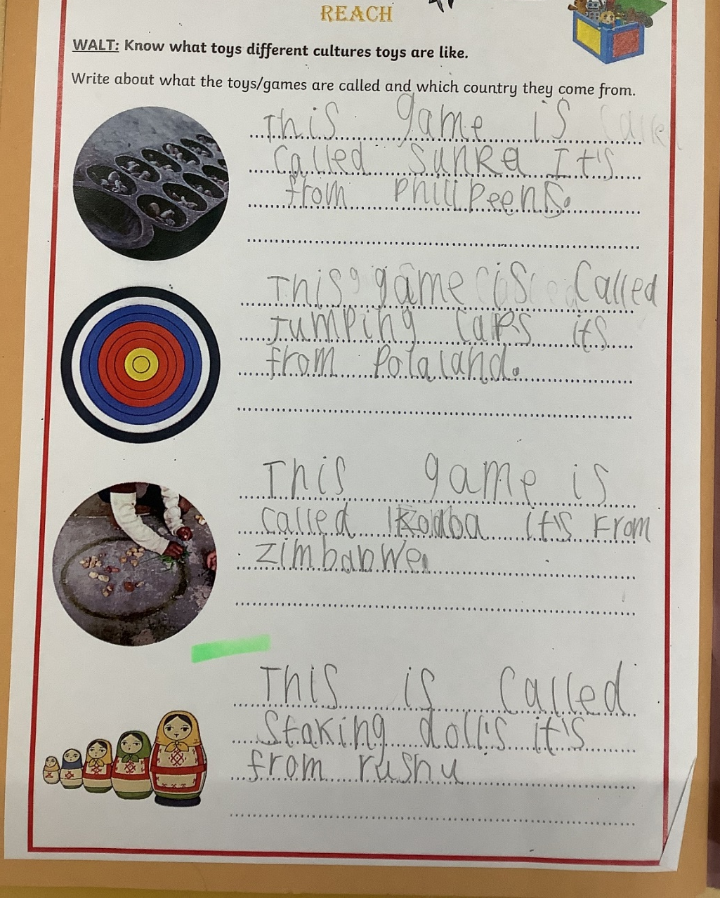
Examples of Year 1 work…

Slide 2
Examples of Year 3 work…

Slide 3
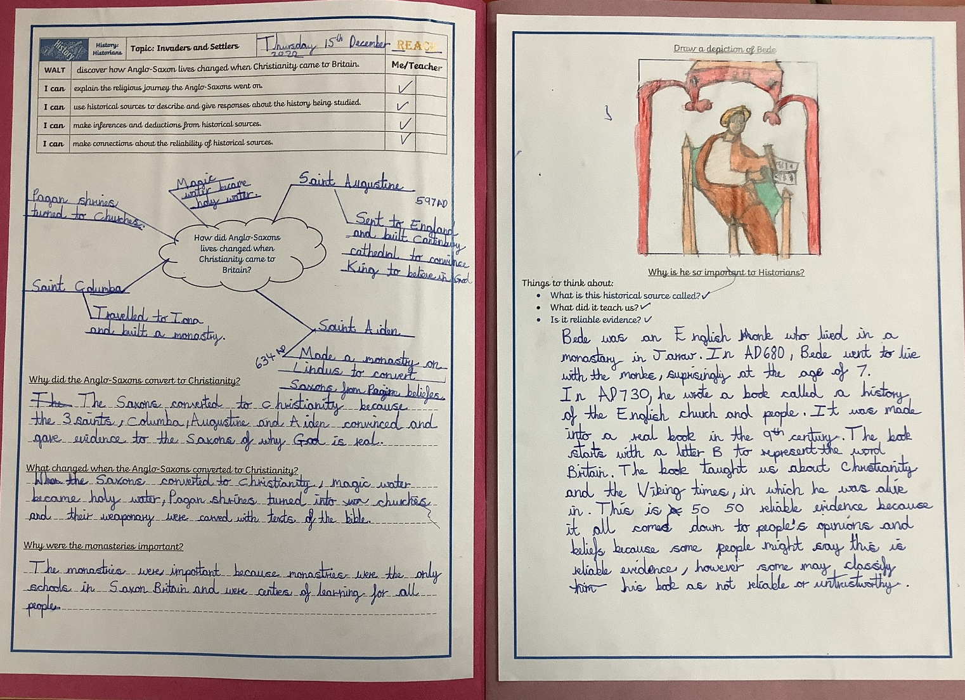
Examples of Year 5 work…

Slide 4
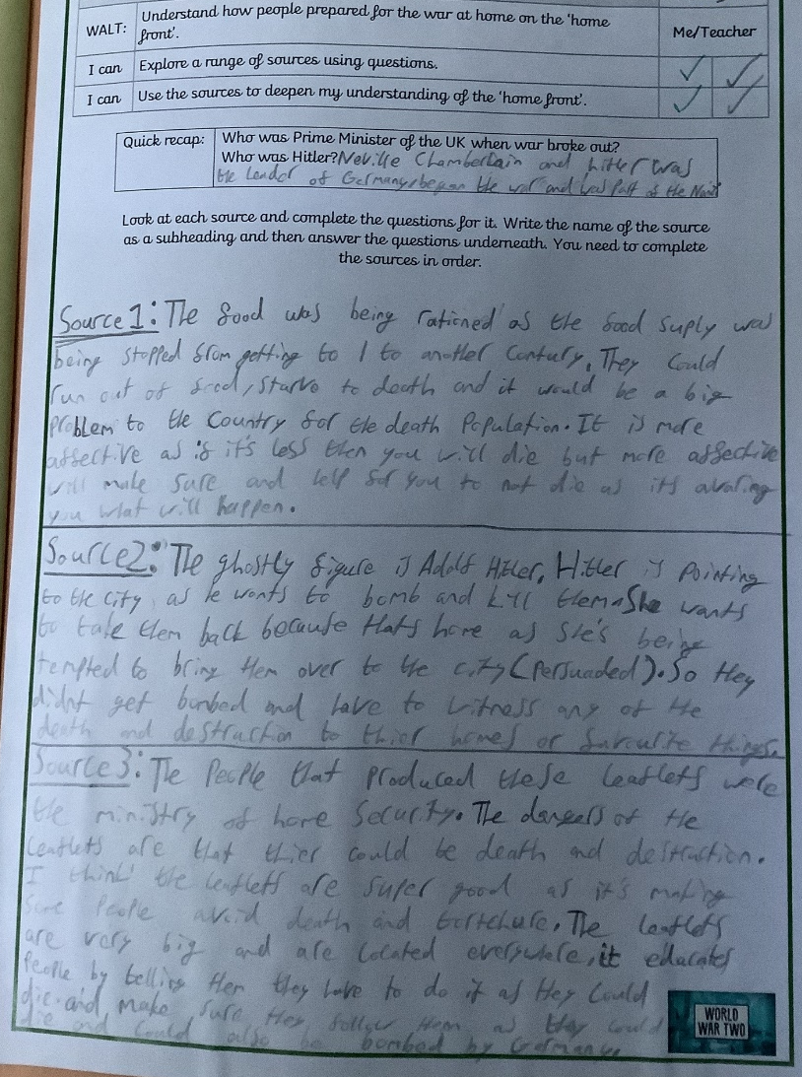
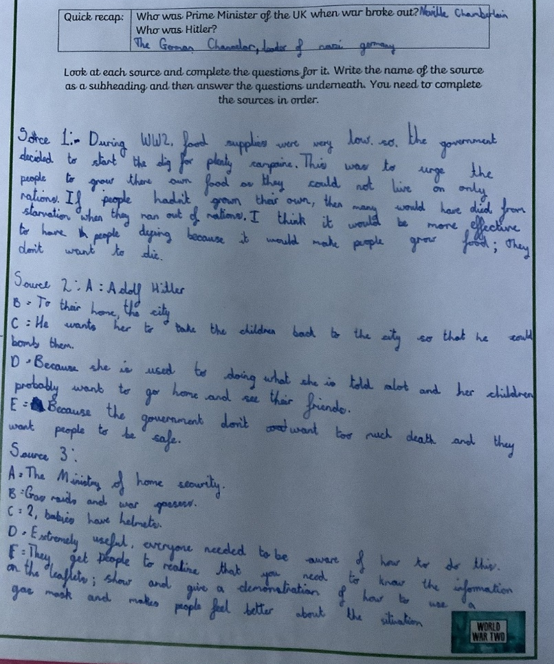
Examples of Year 6 work…

Slide 5
