Slide 1
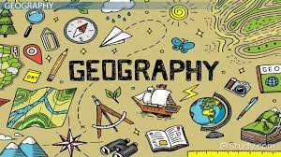
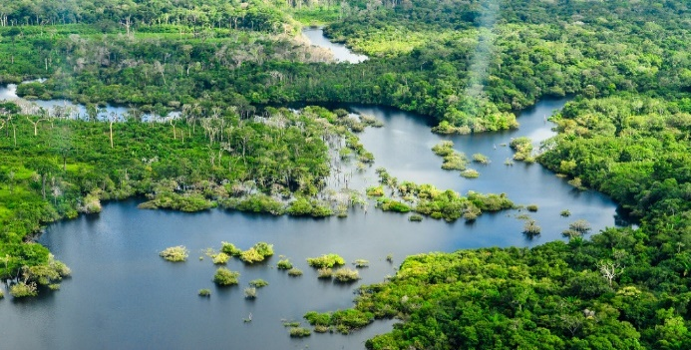













Topic: Rainforests | Year Five
Vocabulary
 | Biodiversity- the variety of living things in one place; like different animals, plants and insets all living together in the same area.
 | Biome- A big area of the world with its own type of weather, plants and animals.
 | Canopy- the top layer of trees where branches and leaves form a type of roof.
 | Deforestation- when people cut down lots of trees in a forest.
 | Emergent layer- the very tallest trees in the rainforest.
 | Forest floor- the bottom of the forest where it’s dark and damp. You will find things like insects, fungi and big animals.
 | Understory- a layer of plants and small trees under the canopy but above the forest floor.
 | South America- A continent on Earth that had countries like Brazil and Peru. It is where the Amazon Rainforest is found.
 | Amazon River- a huge river that flows through the rainforest. It is one of the longest rivers in the world.
 | Rainforest- a forest that gets lots of rain and is warm.
 | Equator- an invisible line around the middle of the Earth. Places near or on the equator are usually hot and get lots of rain (except the deserts).
Sticky Knowledge
Rainforests are found on or near the equator.
Rainforests are hot and wet.
The four layers of the rainforest are: forest floor, understory, canopy, emergent.
Deforestation is the cutting down of trees.
80% of all the food eaten today originally came from the rainforest.
Tribes, who live in the rainforest, have deep connections with the forest.
Scientists believe there are still new species of animal and plant to be discovered.
The Amazon Rainforest produces 20% of all the world’s oxygen.
Skills I will use
 | Comparing I can notice and describe similarities and differences.
 | Map reading I can use a map to understand what a place looks like.

