Slide 1
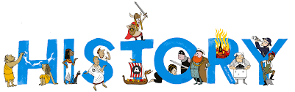
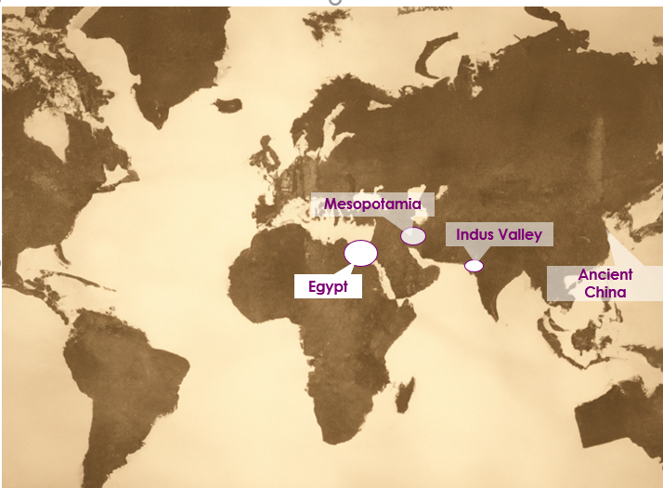













Topic: Ancient Egyptians | Year Four
Vocabulary
 | The term to describe history before 500AD.
 | An object made by human beings.
 | Way of life of a group of people.
 | A ruler of Ancient Egypt who was very wealthy who the people thought came from the sun-god Ra.
 | Stone structure that has a square base and sloping triangular sides that join at the top built to house dead bodies of their kings who were like gods living on earth.
 | Sculpture with lion’s body and head of the ruler built to guard the pharaoh in the afterlife.
 | Grave or building where body of dead person is laid.
 | Symbols used by Ancient Egyptians in their writing.
 | A way of preserving a body after death.
 | Paper made from the stems of the papyrus plant.
Sticky Knowledge
Ancient Egypt is just one of 5 major ancient civilisations which emerged about 5000 years ago.
Egypt was ruled by Pharaohs who were seen more like a god than just a person.
Much of daily life in Egypt was influenced by the Nile which flooded every year, essential for growing crops.
The Egyptians thought that people who died went to a new world and we have lots of artefacts used in the mummification process.
Much of what we know for sure about Ancient Egypt comes from the Rosetta stone discovered only 200 years ago.
The Egyptians worshipped hundreds of gods, many represented by animals.
Skills I will use
 | Comparing I can notice and describe similarities and differences.
 | Observing I can observe what I see.
 | Analysing I can analyse historical sources.

