Slide 1
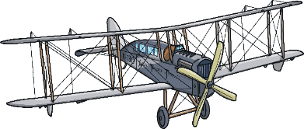
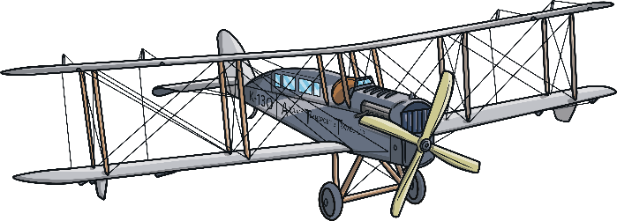
St Joseph’s Class Spring Term 2 Topic Web
Through Computing we will…
Learn basic functions of a computer including using a mouse, typing our name and saving documents.
Identify rules for keeping ourselves self when using technology in and beyond the home.
Explain technology as something that helps us.
To be Historians we will…
Understand what flight is.
Compare flight past and present.
Investigate and know the importance of the Wright Brothers, Amelia Earhart, Bessie Coleman and Frank Whittle.
To be Leaders of Faith we will…
Continue to deepen our understanding of the Catholic Faith through the season of Lent.
As Mathematicians we will…
Partition numbers 17 through 20.
Recognise halves and quarters.
Use mathematical language to describe movement (whole and half turns).
As scientists we will…
Use our senses to observe and record data about the spring term.
Through Design Technology we will:
- Explore, design and construct free standing structures.
As writers we will…
Write our own fairy-tale stories, using how and what statements for exclamation.
Write instructions, using time conjunctions.
To be healthy we will...
Explore travel and balance through gymnastics and dance.
Perform dance through movement patterns.
As children Created to Love Others we will…
Know the value of ‘sorry’ and recognise how our behaviour can impact others.

