Slide 1
Year 6 Leavers Awards
2020

Slide 2
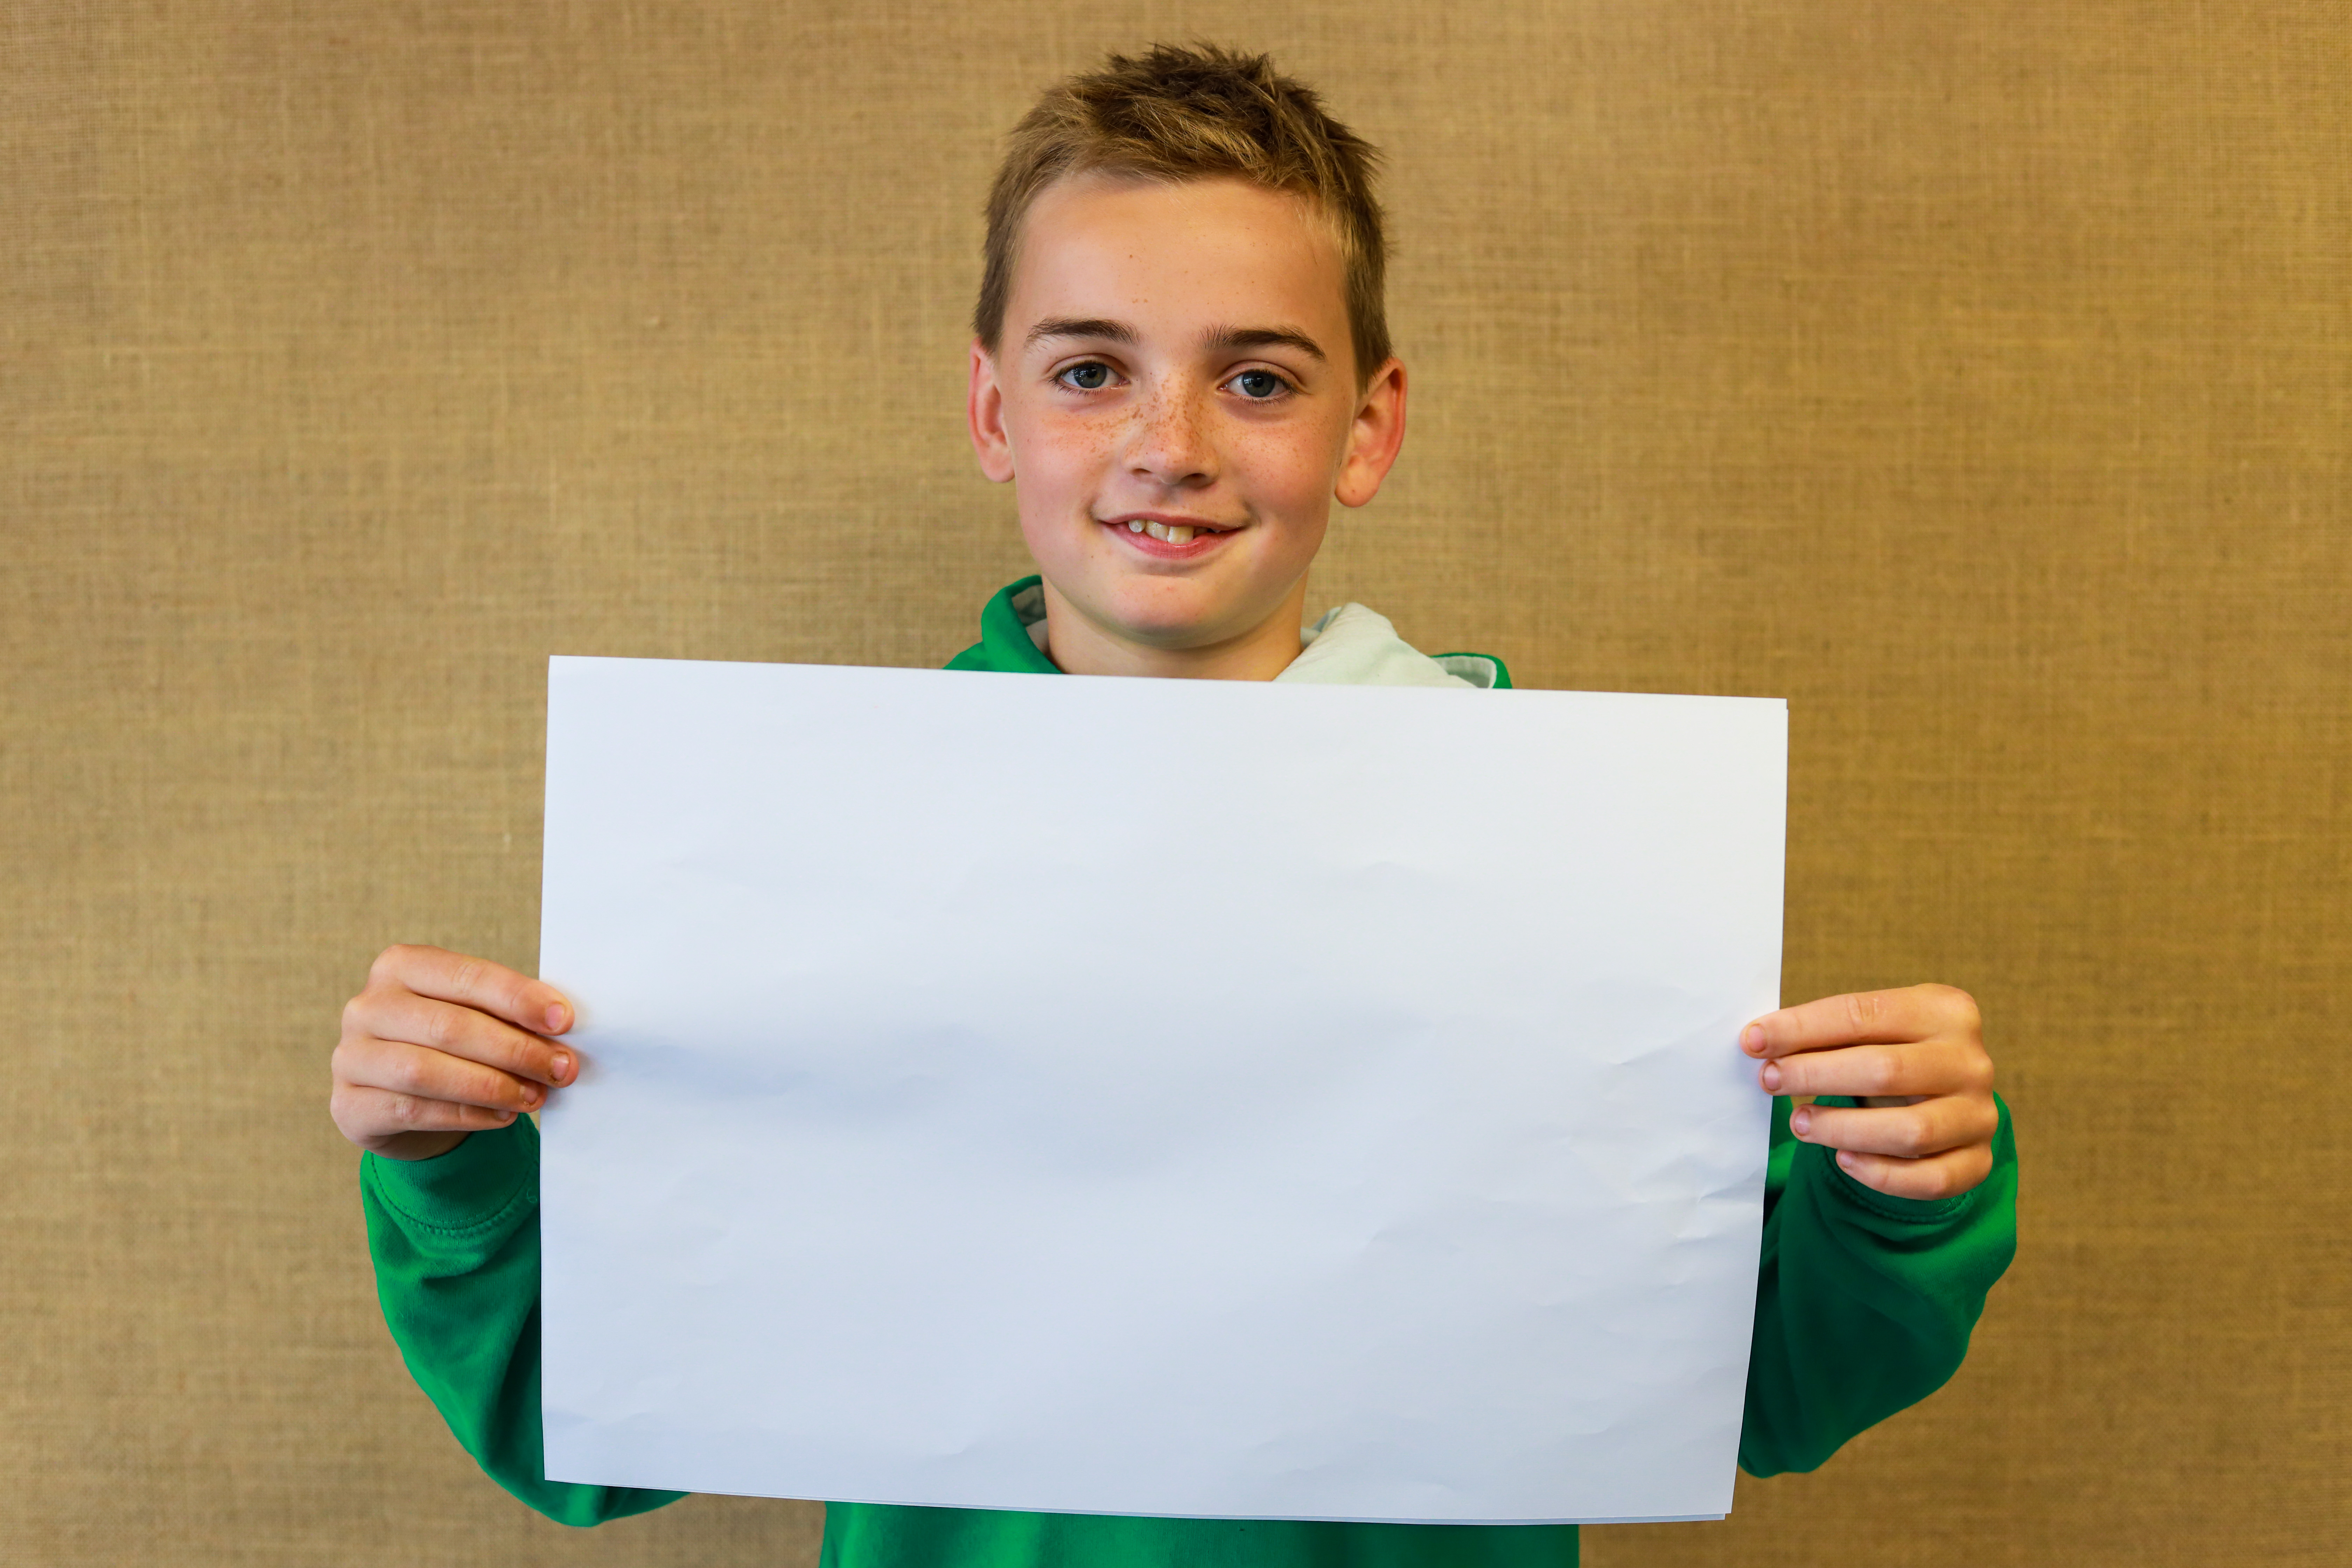
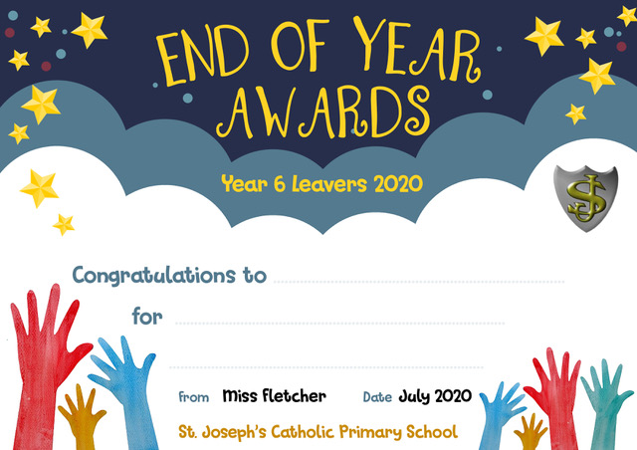
Freddie Nicholls
Being the best person to be stranded on a desert island with

Slide 3
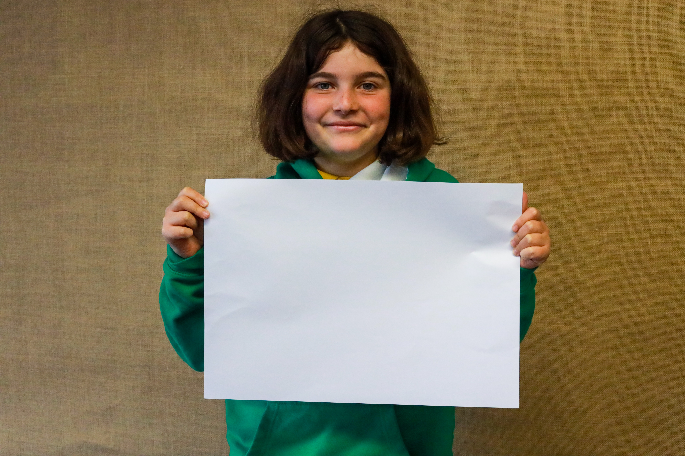
Prudence Herbert
Being Little Miss Chatterbox

Slide 4
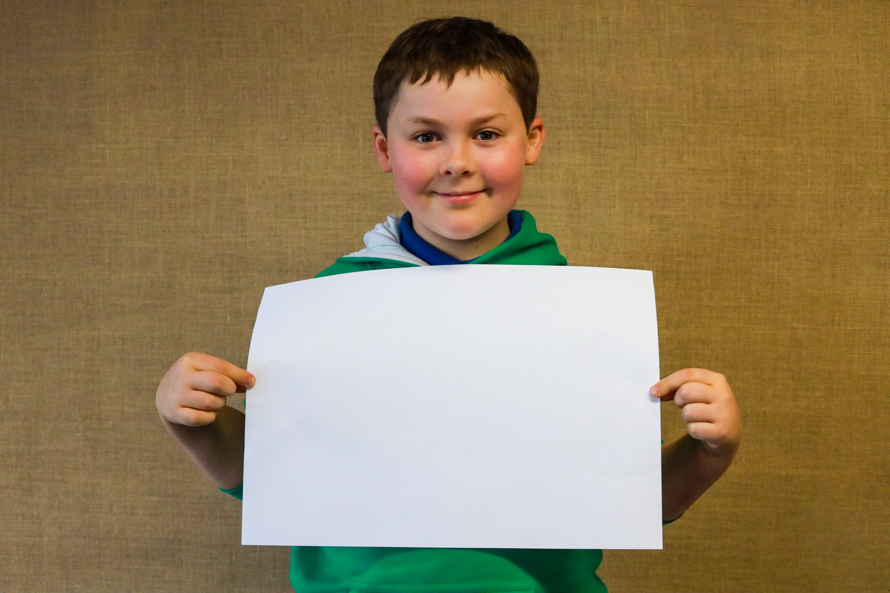
Freddie Samuel
Being the most fearless

Slide 5
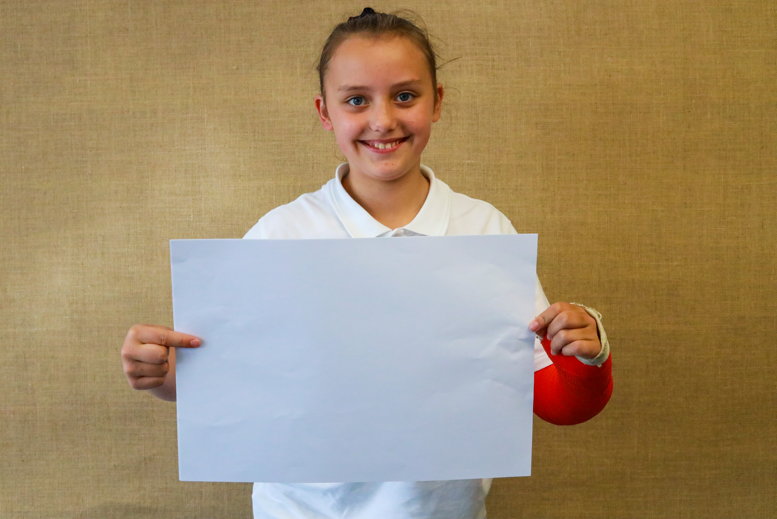
Lily Tarr
Having the best laugh

Slide 6
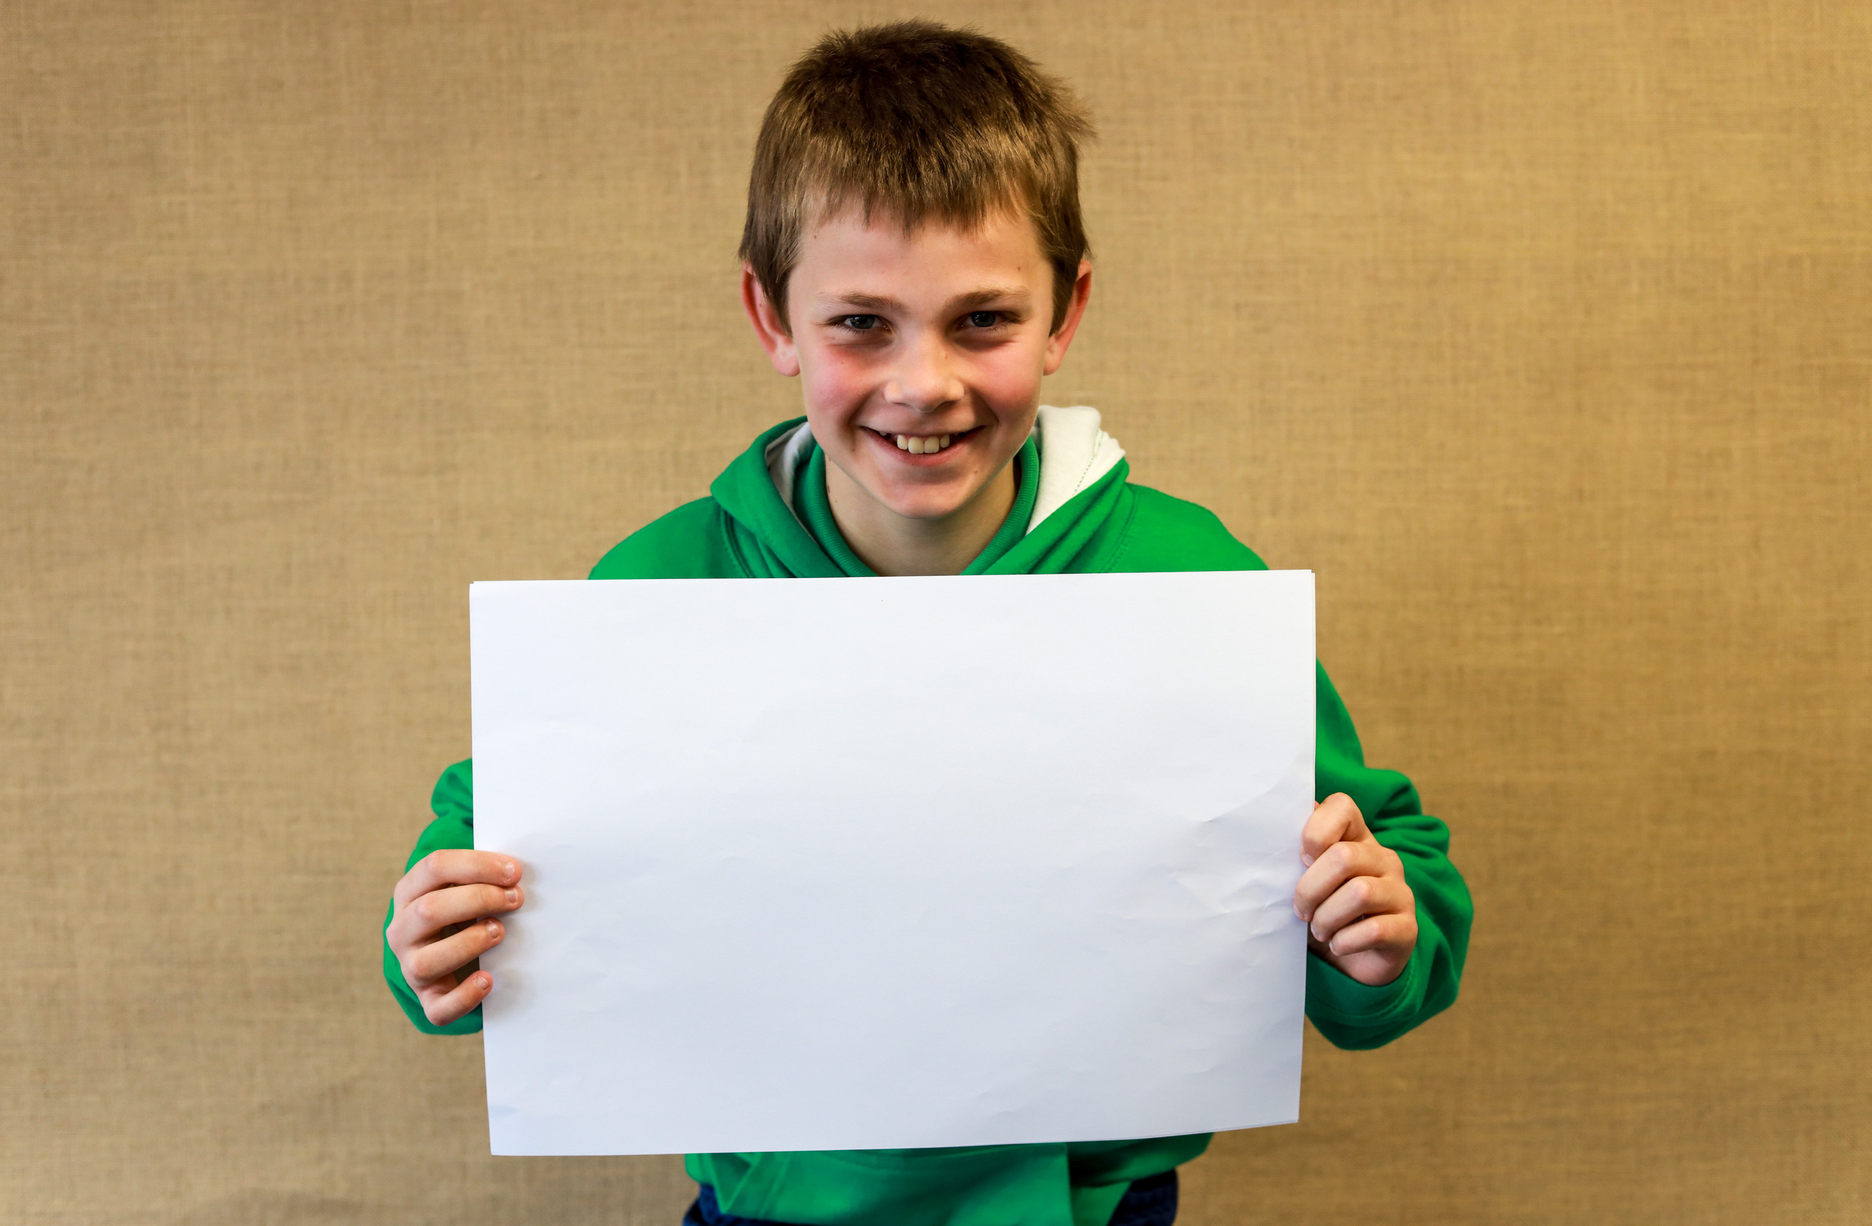
Leo Tiley
Being the most responsible

Slide 7
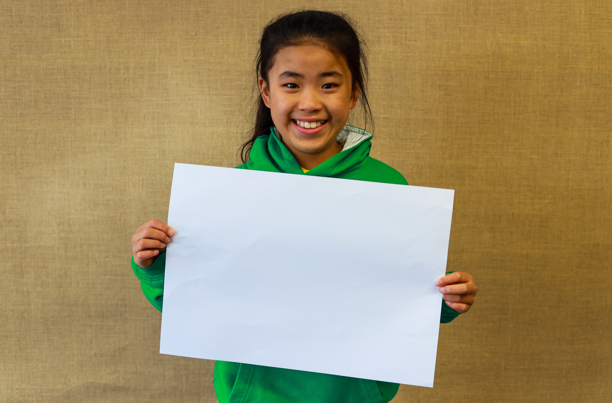
Posy Dominey
Being the most likely to become President (of the world)

Slide 8
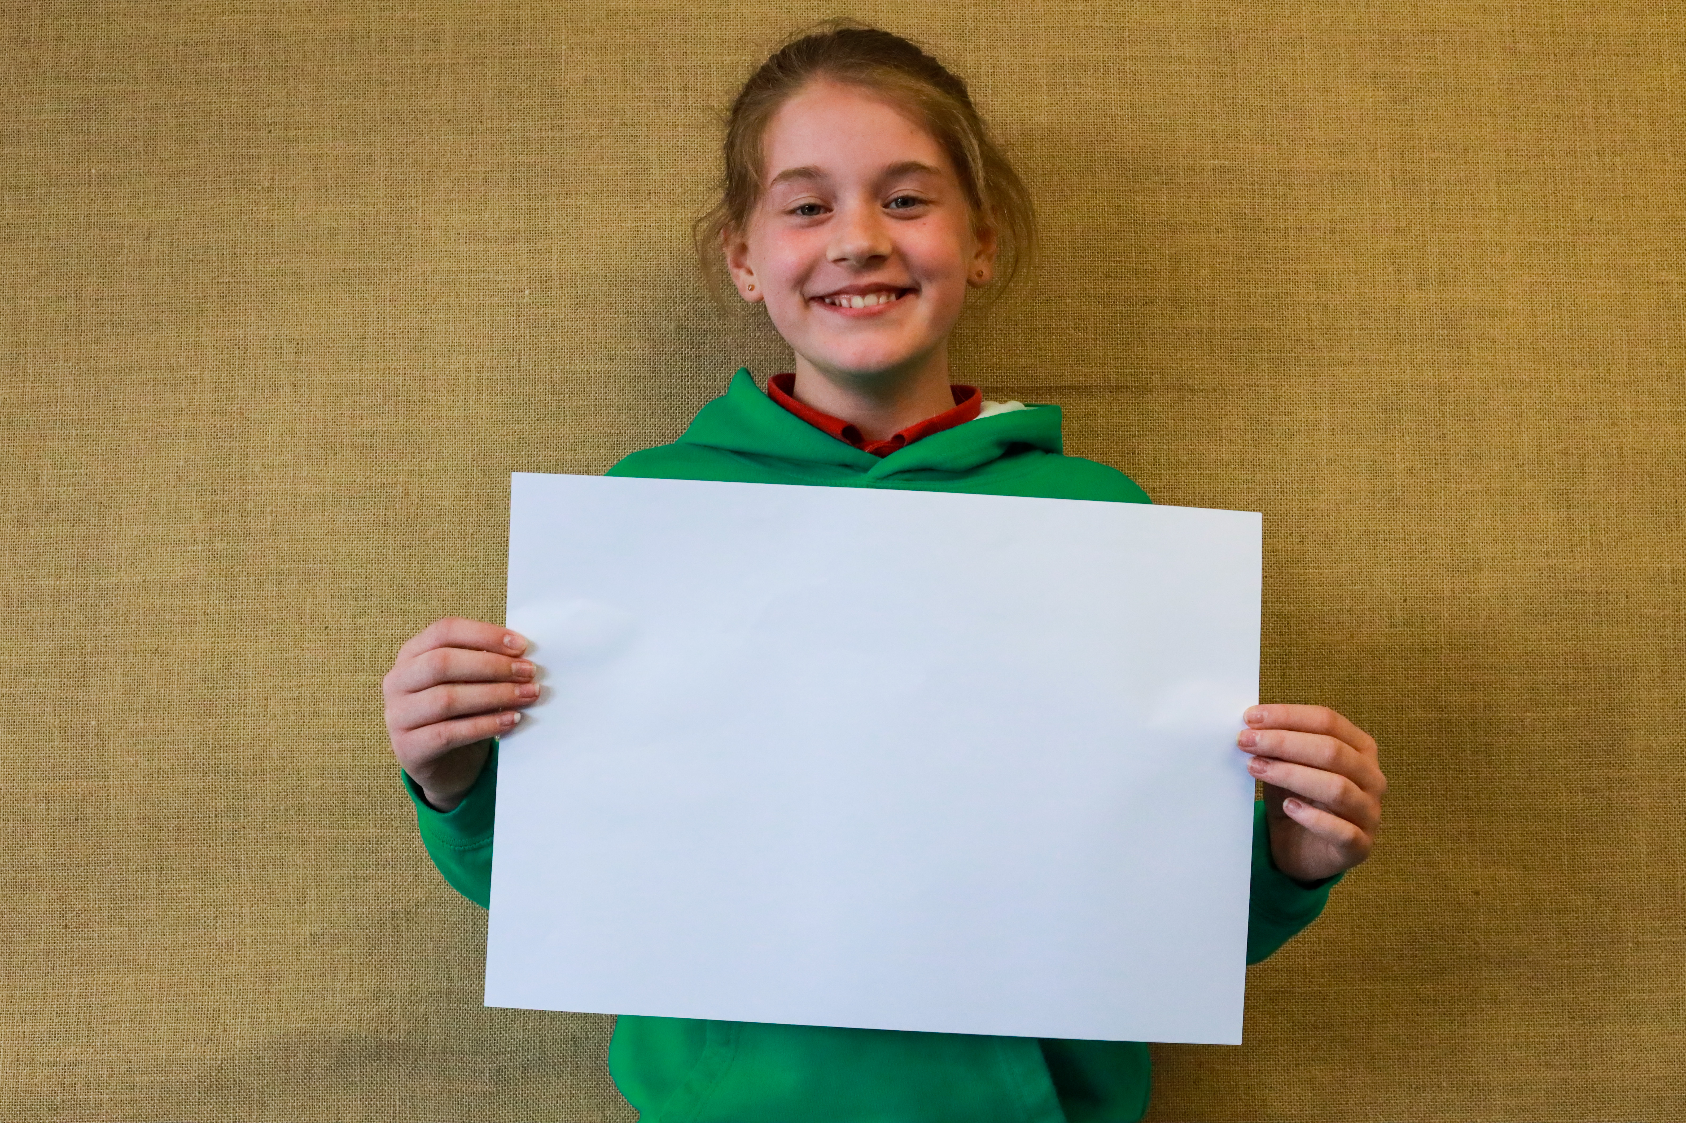
Ava Ferris
Being the most likely to run away with the circus!

Slide 9
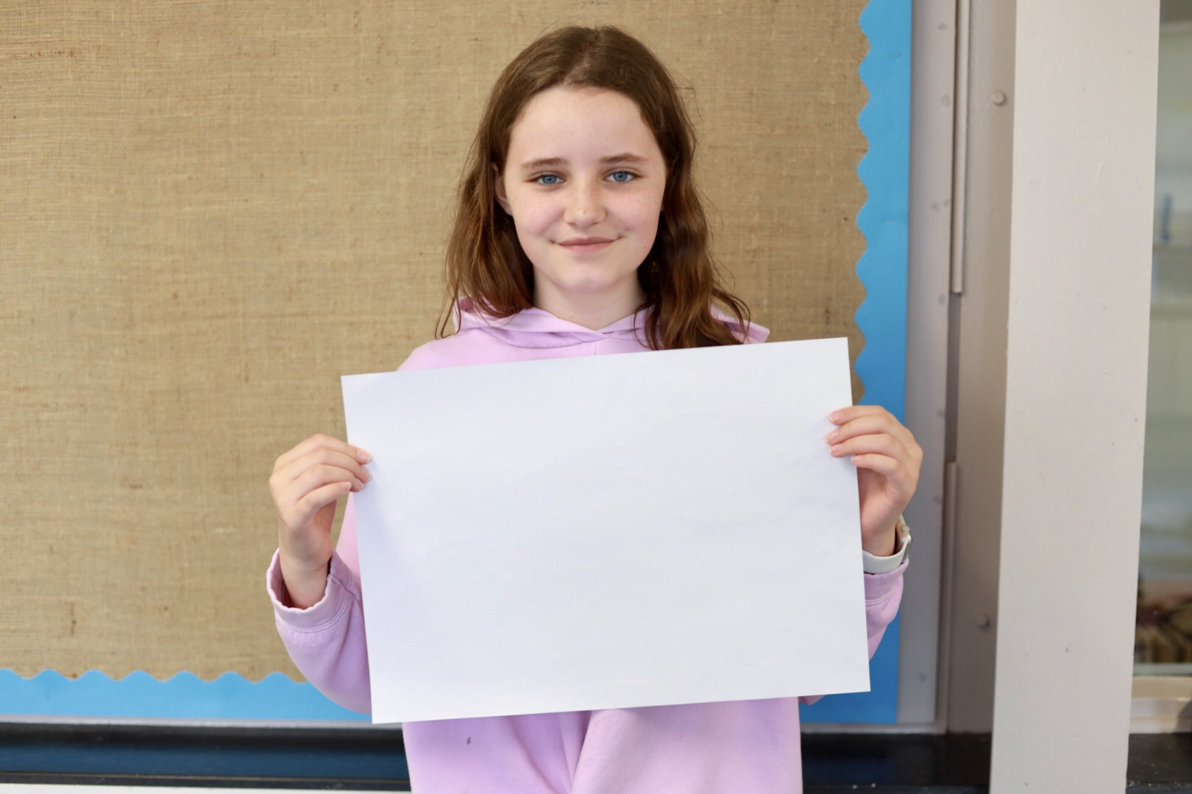
Gracie McPherson
Being the most thoughtful

Slide 10
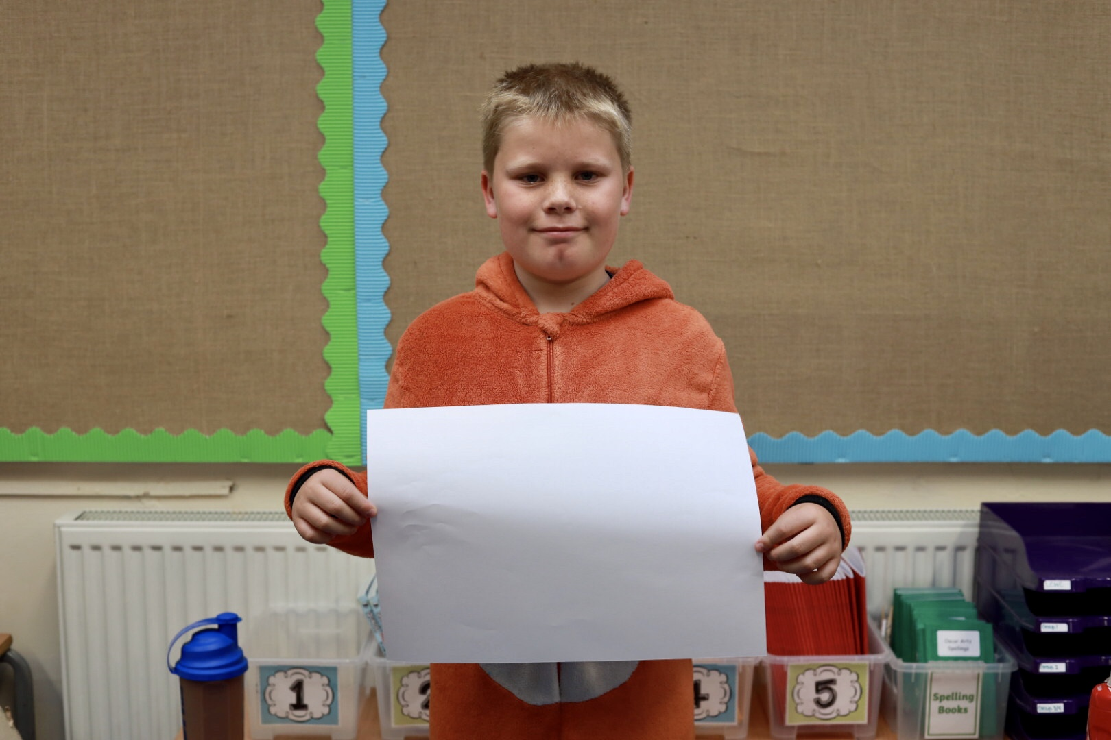
Alfie Gordon
Being our class comedian

Slide 11
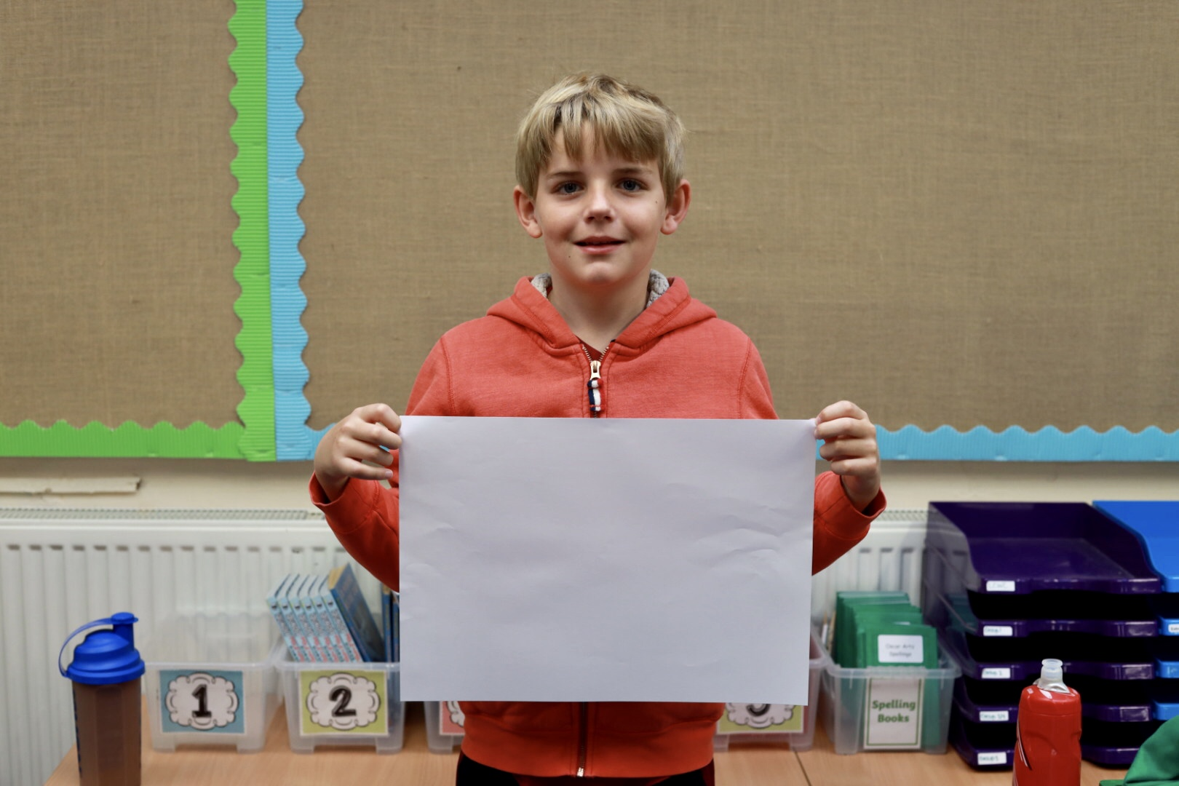
Ted Wallace
Always having a funny sarcastic comments

Slide 12
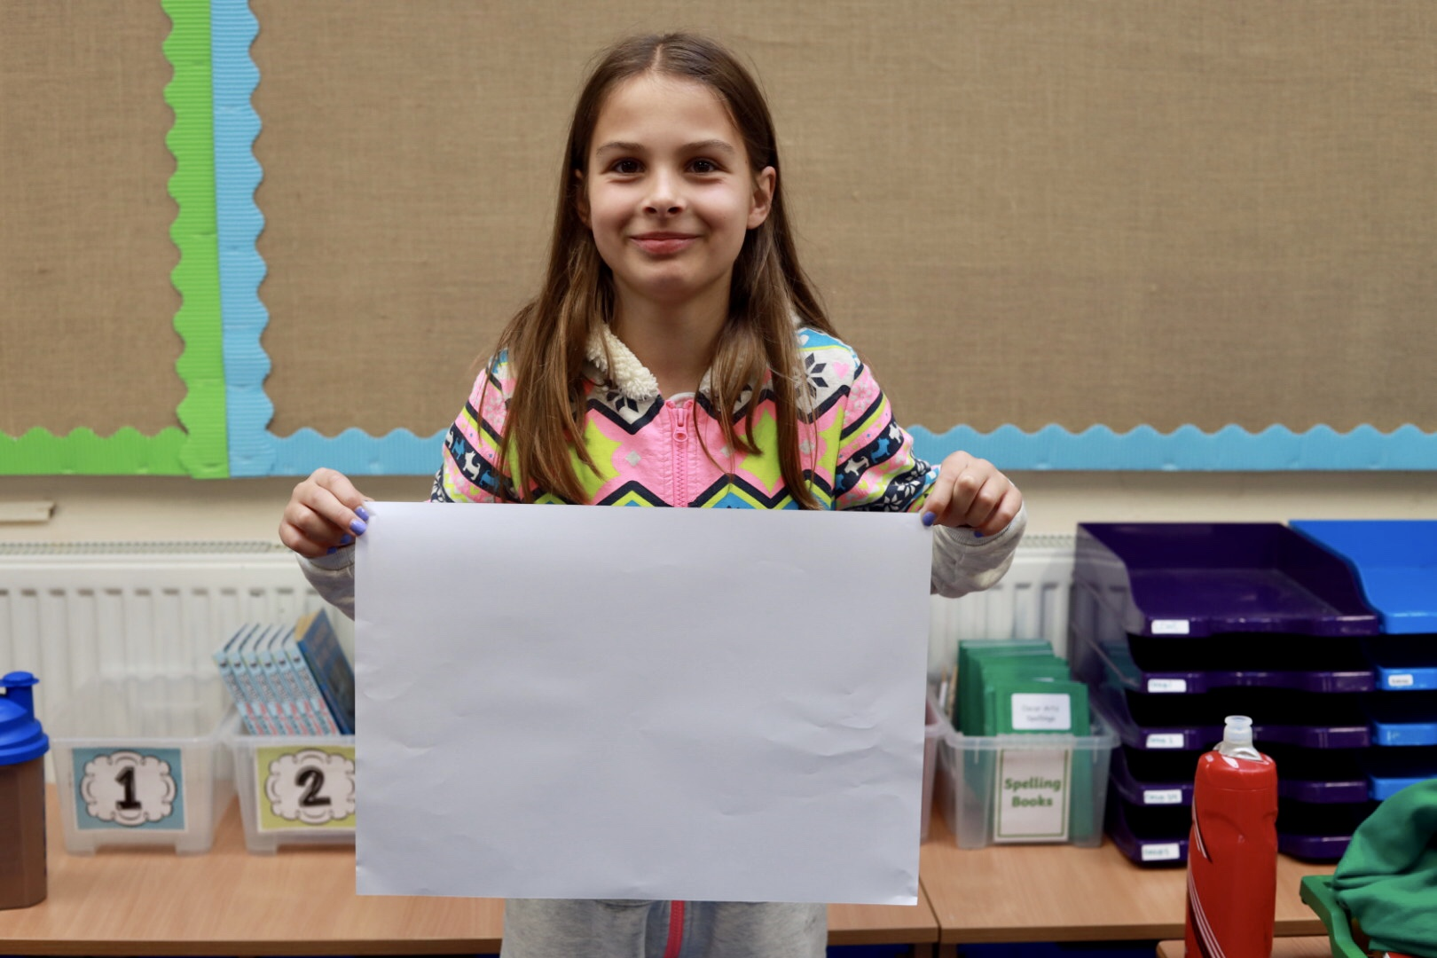
Matilda Williams
Being the most likely to become a zoo keeper

Slide 13
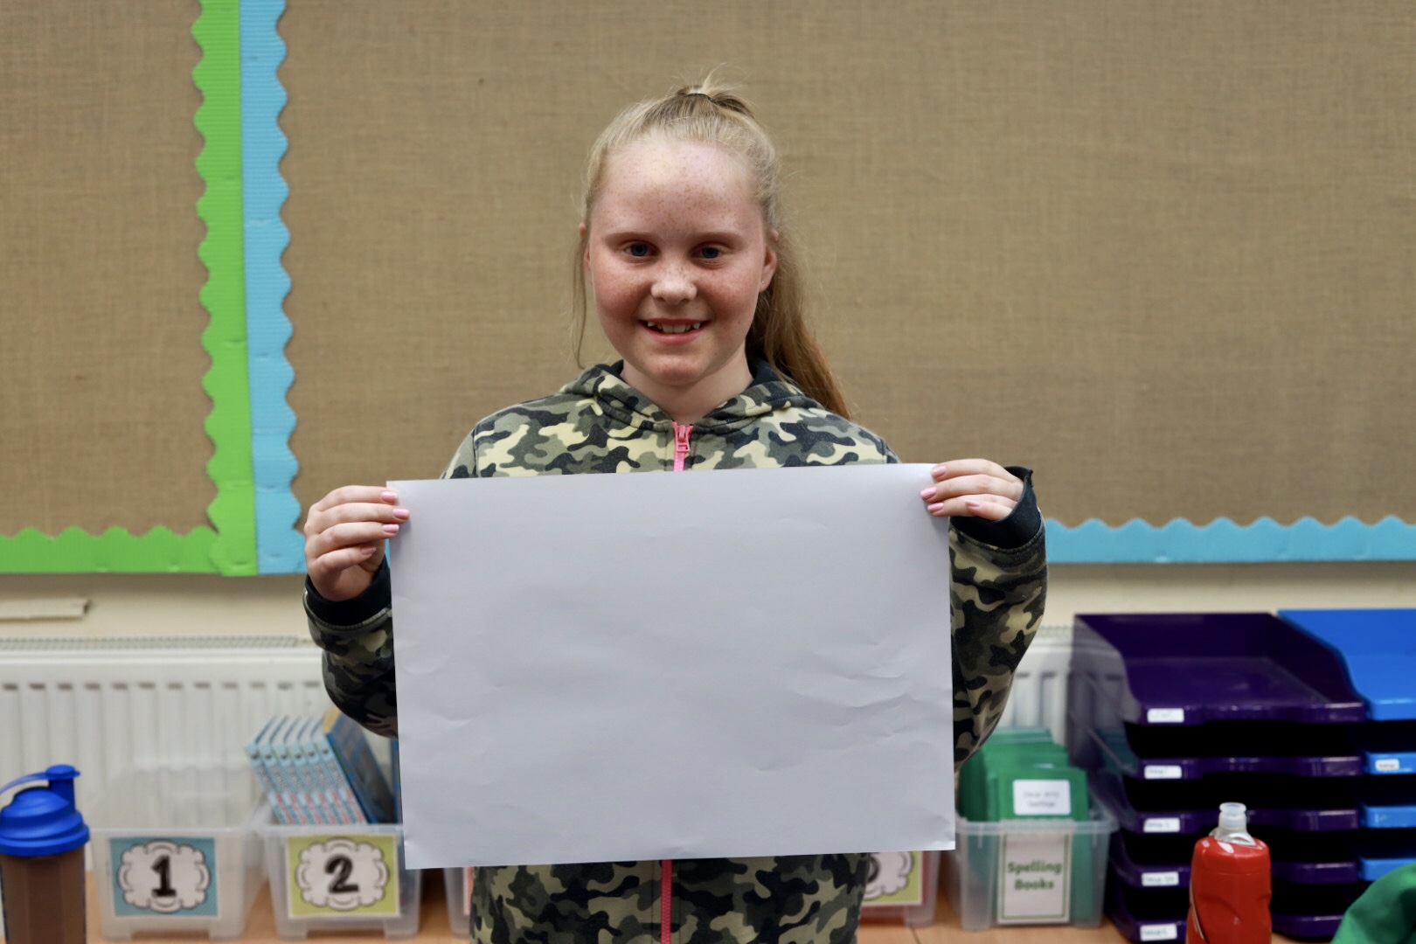
Layla Pegler-Smith
Having the kindest heart

Slide 14
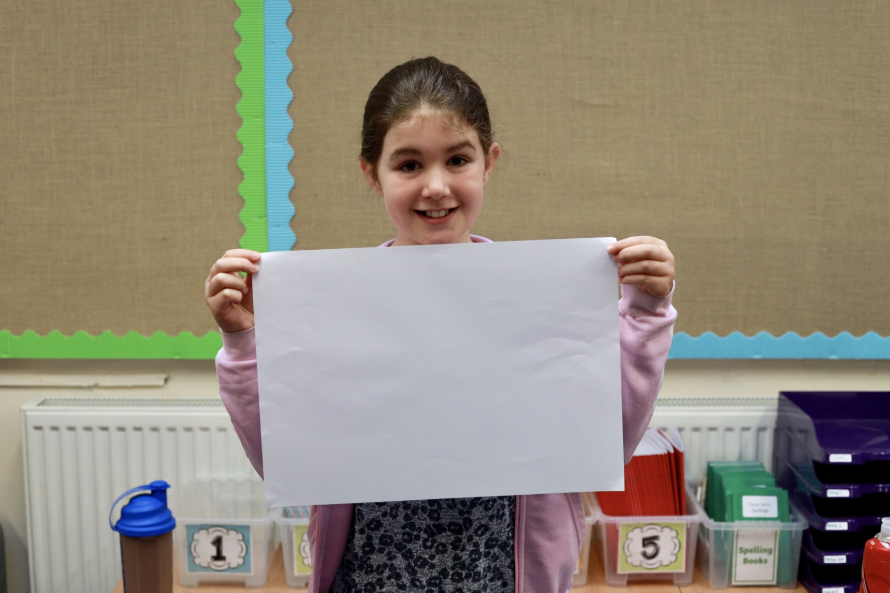
Emilia Spencer
Being a first class friend

Slide 15
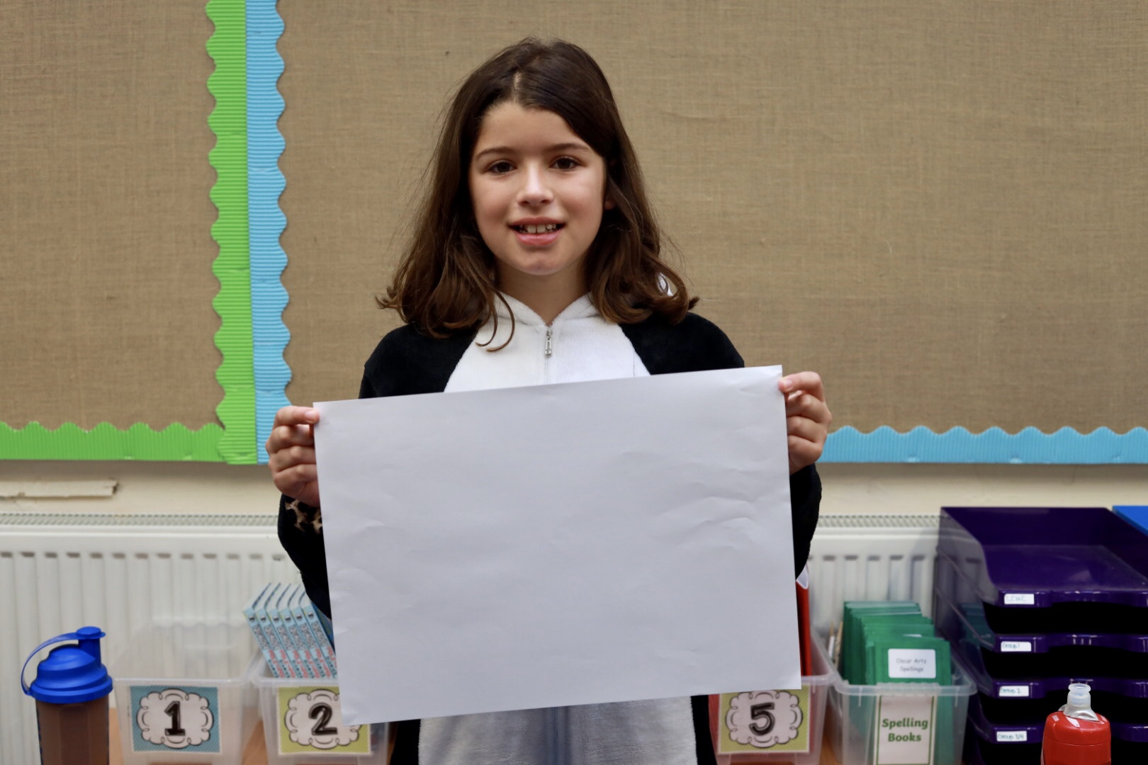
Willow Carter-Smith
Being totally, brilliantly BONKERS!

Slide 16
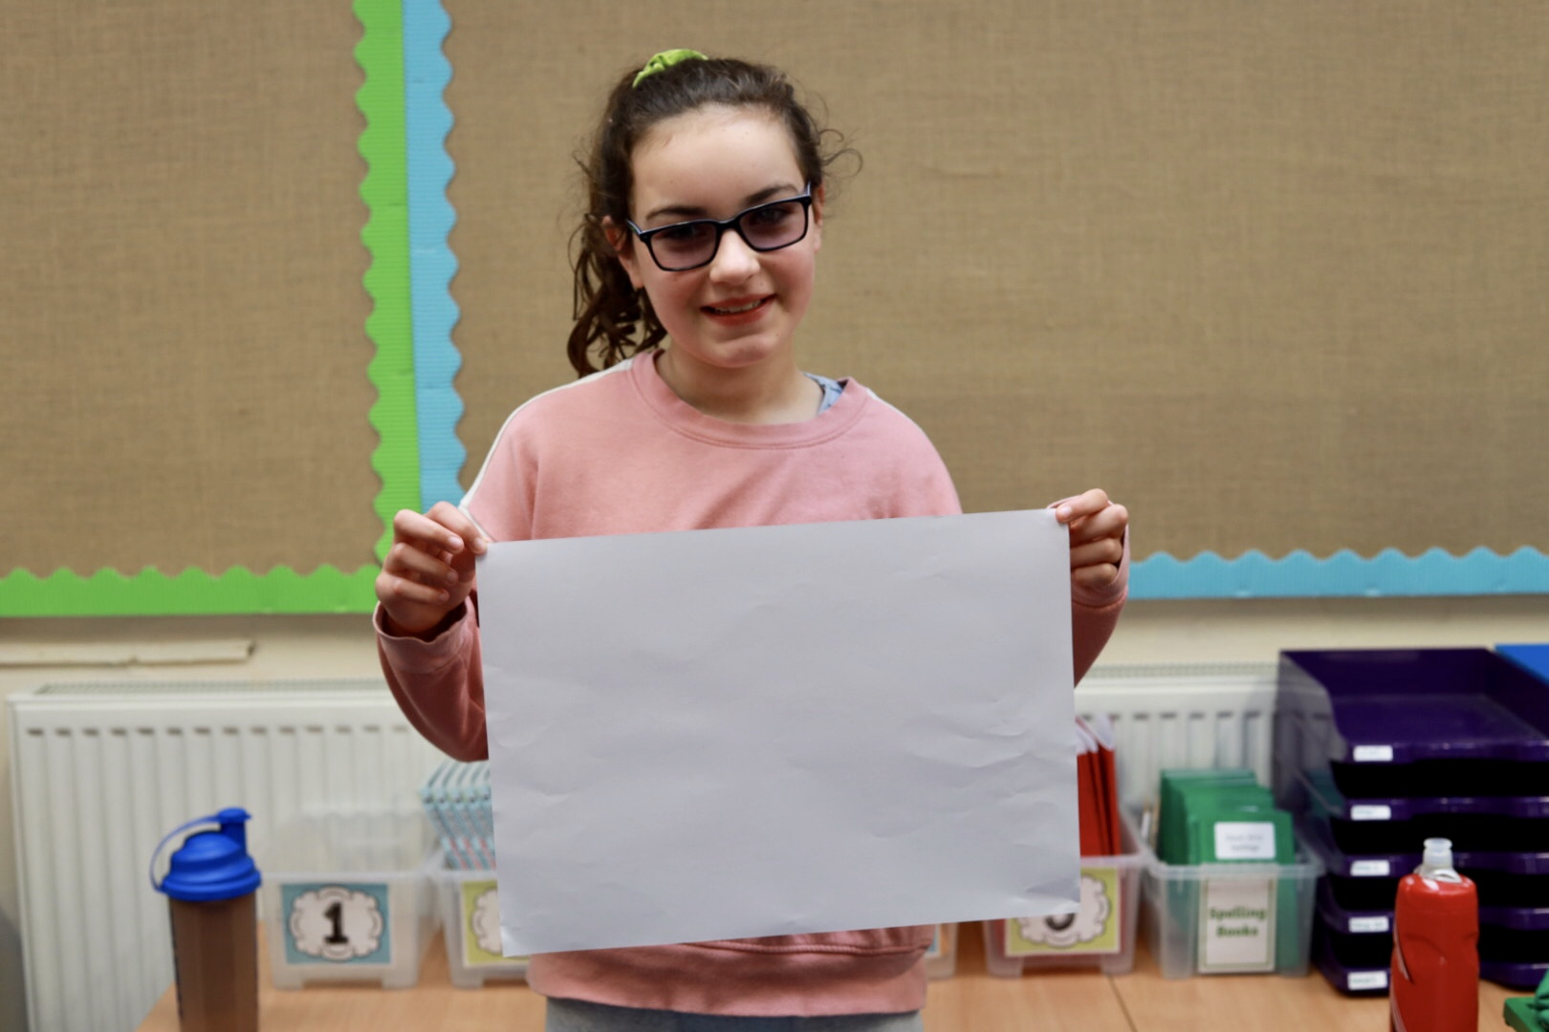
Ayla McKeever
Being the most likely to become a leading news reporter

Slide 17
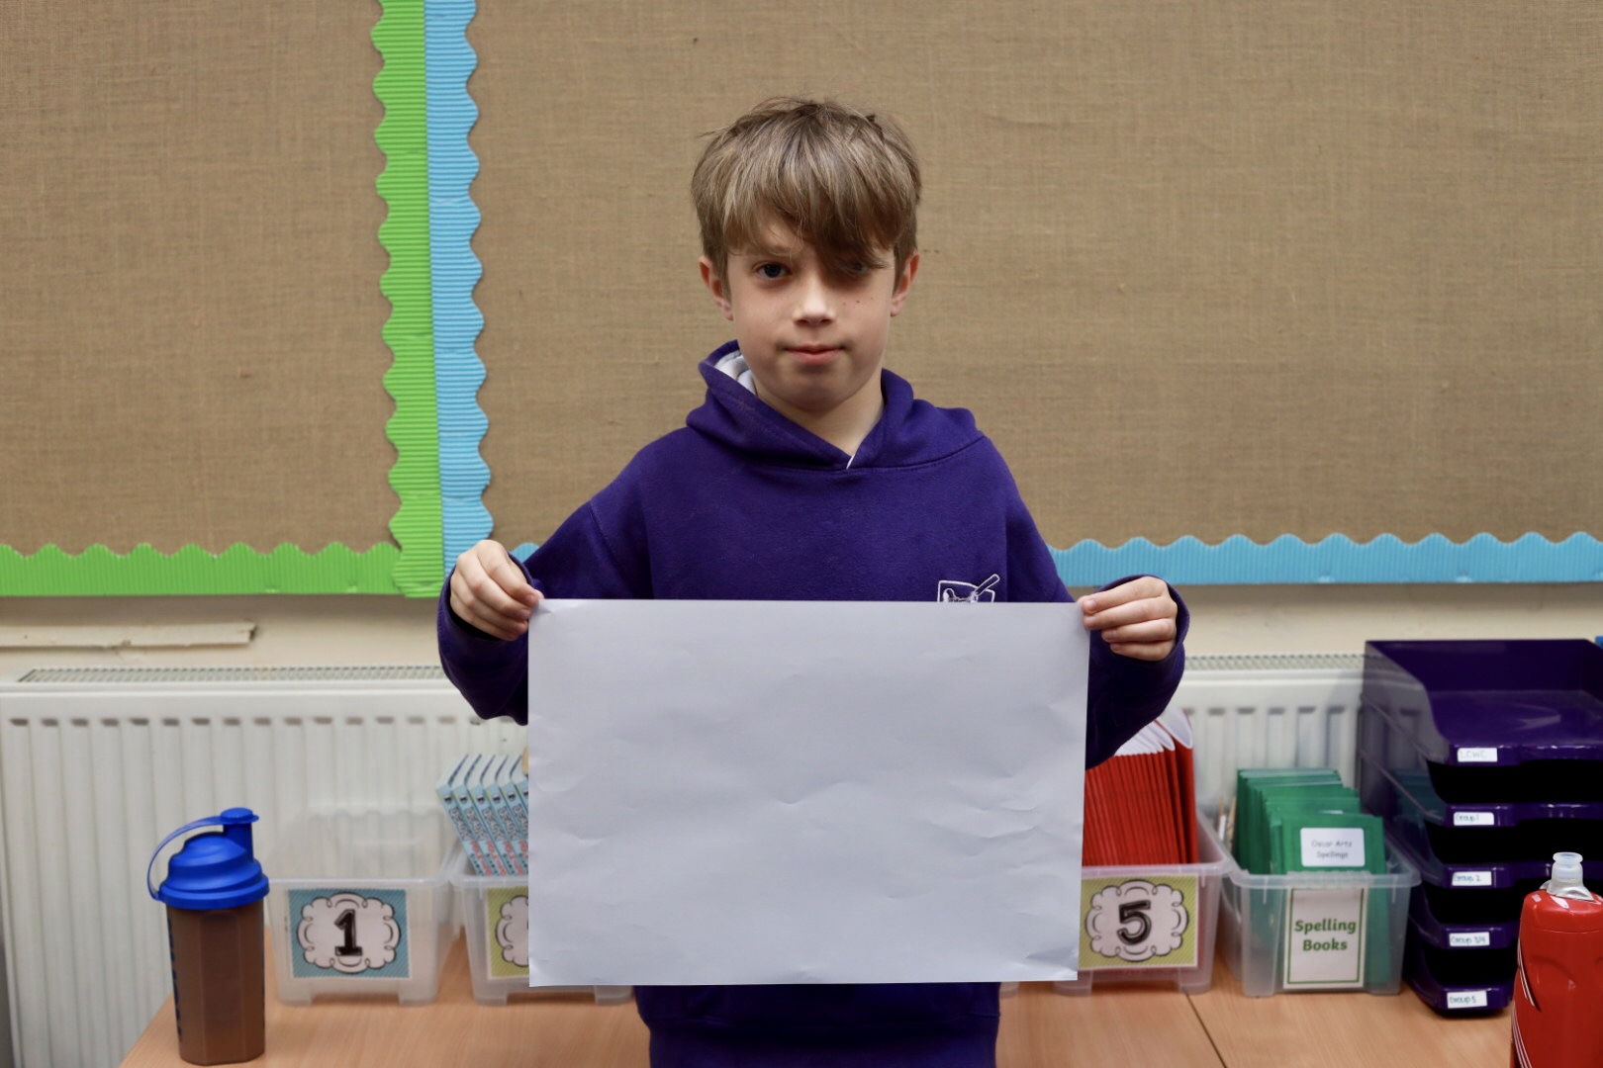
George Harrold
Being the most likely to
become a pro-gamer

Slide 18
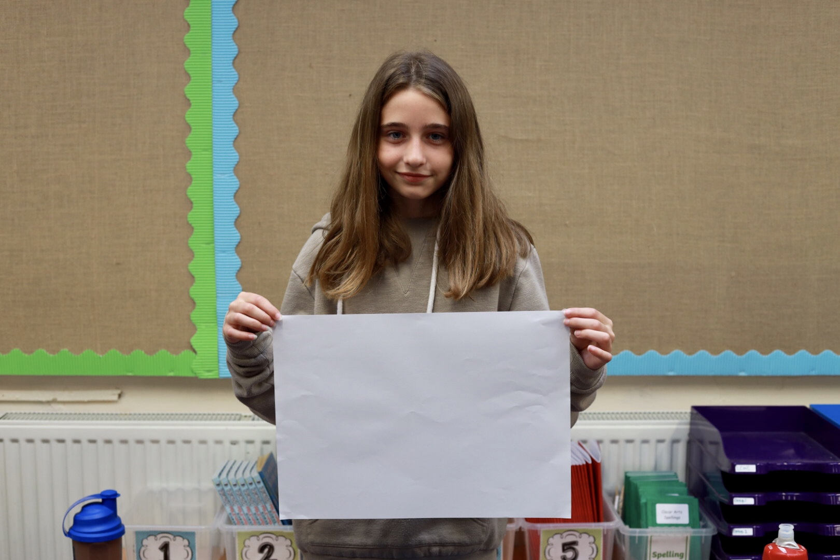
Holly Stewart
Being a part time teacher

Slide 19
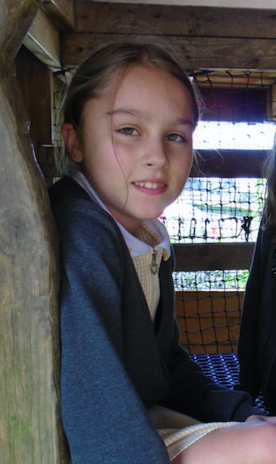
Ruby Dickinson
Having the best style

Slide 20
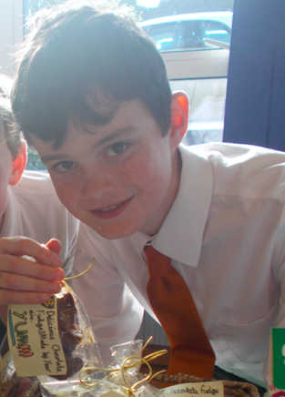
Holly Stewart
Being a part time teacher
Connor Riggall
Being the most chilled

Slide 21
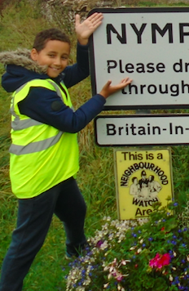
Dylan Hilling
Always using the most unusual vocabulary in his work

Slide 22
Freya Musgrave
Most likely to be found creating dance on the playground
Miss Crisp

