Slide 1
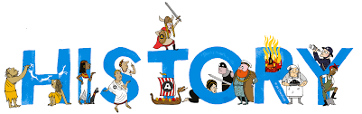
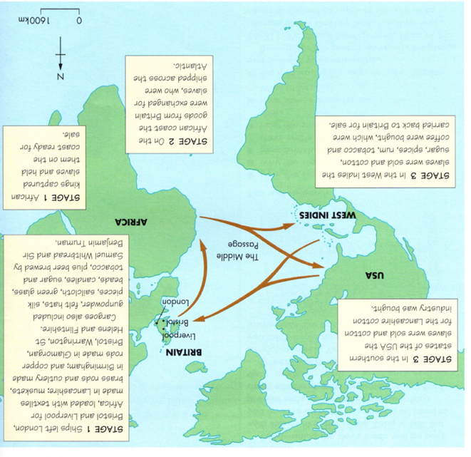
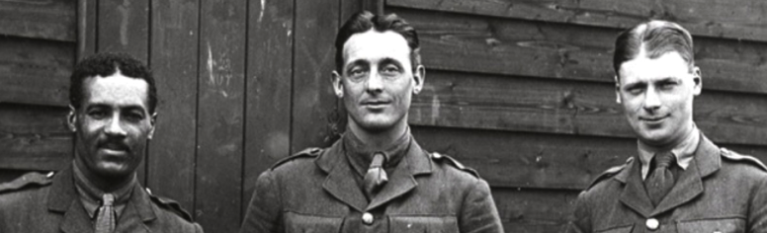











Topic: Equality for All – Black and British | Year Six
Vocabulary
 | Abolition - Ending of slave trade and slavery.
 | Atlantic Slave Trade - Between 1640 and 1807 millions of Africans taken to America on ships to be slaves.
 | Commonwealth - Group of over 50 countries once part of the British empire.
 | Discrimination - Unfair treatment of people based on unreasonable ideas about the person or group.
 | Empire - large group of places controlled by one powerful country.
Middle Passage | Horrific journey that Africans were forced to take across the Atlantic as slaves.
 | Migrant - A person who moved from one country to another.
Prejudice | Opinions against certain people not based on reason or actual experience.
 | Racism - the unfair treatment of people who belong to a different race.
Segregation | Keeping people from different races apart.
Windrush | The ship Empire Windrush is remembered today for bringing over a thousand post-war West Indian immigrants to the United Kingdom and its arrival has become symbolic of the generation of Commonwealth citizens who came to live in Britain between 1948 and 1971.
Sticky Knowledge
There have been black people living in Britain through much of history , all the way back to Roman times.
Black people suffered horribly as slaves working on plantations in the Americas, but they also worked as slaves in rich people’s homes in British cities.
Black people served in the trenches in World War One and as pilots in the Second World War.
The best-known and most significant period of black immigration came with the arrival of SS Windrush in 1948 to work in the NHS and on the buses. Many black people living in Britain today can trace their ancestors back to this time.
Life has not always been easy for black people living in Britain over the last 75 years so there have had to be laws to prevent discrimination.
The recent Black Lives Matter campaign is an attempt to show how far we still have to go to make sure black people are treated equally.
Skills I will use…
 | Chronological Understanding I can place events in the correct order and understand how things changed over time.
 | Evaluate I can evaluate sources to find out about the past and ask questions about what they show.
 | Cause and Consequence I can explain why things happened and what effects they had on people.

