Slide 1
Welcome to our
Parent Forum

Slide 2
What is the parent Forum?
The Parent Forum will be an informal meeting where parents are invited to be consulted on school issues, give their views and raise areas for discussion.

Slide 3
What is the Parent forum not
Parent governors – they sit on the Local Governing Committee and lead the strategic development of the school.
PTA – they are a separate legal entity who are registered as a charity, raising money to support different aspects of the children’s school life.

Slide 4
Terms of Reference….As a member of the parent forum I agree to:
Show respect to all members of this forum, by listening to and respecting a diverse range of opinions
Allowing everyone the opportunity to speak
Stick to agreed timescales for discussion of topics
Maintain confidentiality by not mentioning the names of individual members of the community
Avoid discussing individual circumstances. These issues will be directed via the school’s communication procedure instead

Slide 5
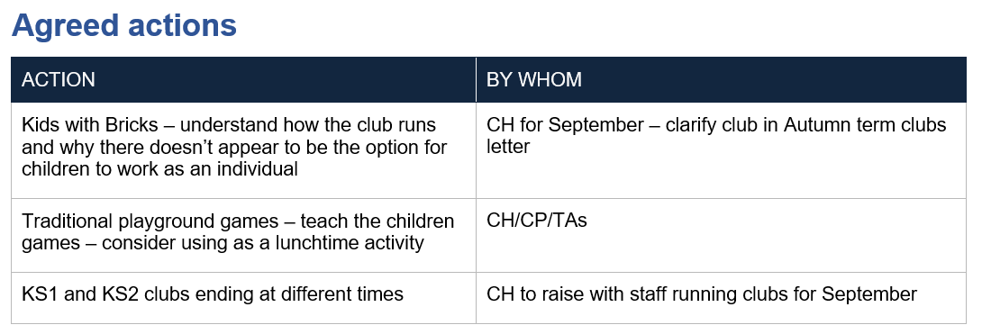
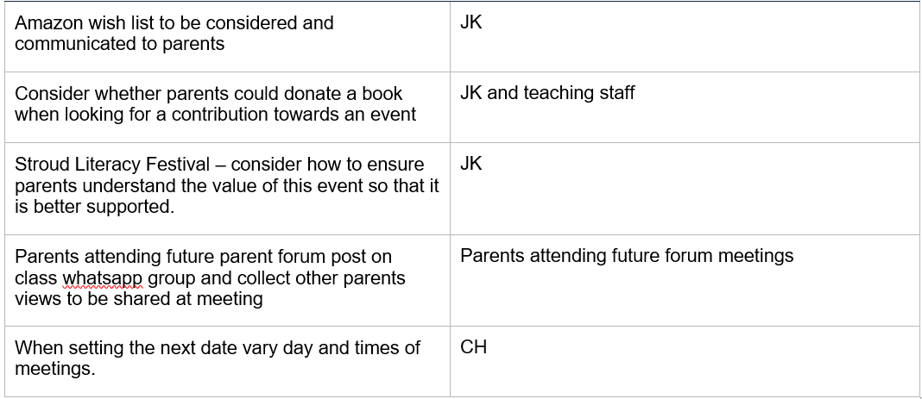

Slide 6
Opportunities for Parents to come into school

Slide 7
Phonics Evenings Mystery reader Story time at the convent reception and Year 1 Soup Kitchen KS1 harvest Remembrance Retreats and stations of the cross Class Mass Nativity Carol Concert Community carols Christingle Parents evenings World book day Music concerts House music competition Year 4 violin concert Dance performance End of club celebrations, drama, art | Health week British Science Week Sports day Celebration of whole school activity Whole school picnic PTA events

Slide 8
Any ideas for further opportunities?

Slide 9
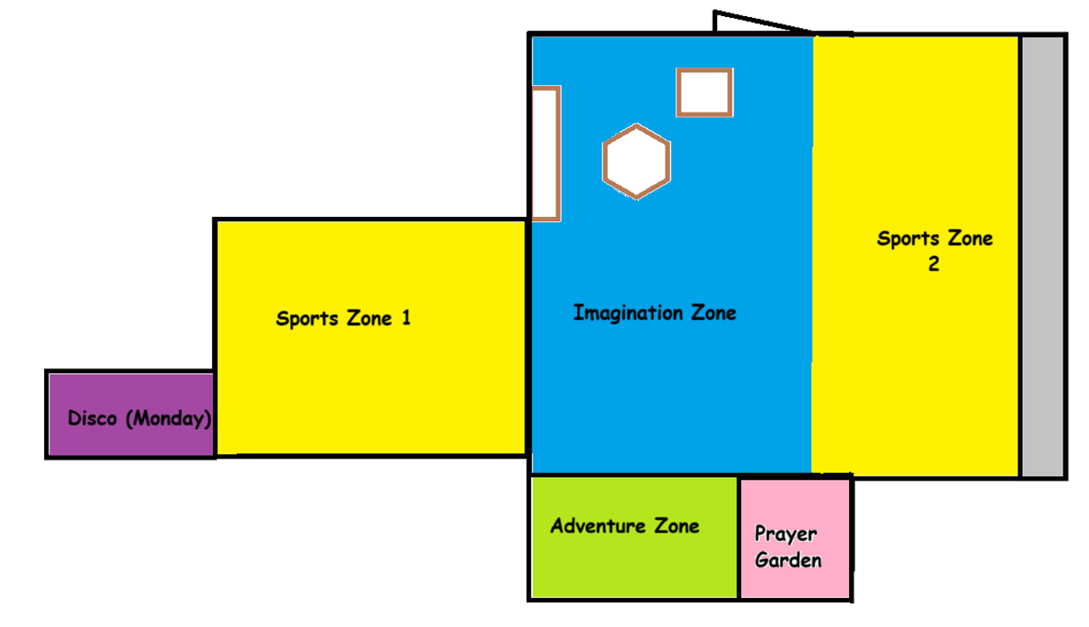
Play Time as St Joseph’s
Why?
The need of our most vulnerable students, which positively impacts all of our students.
Parent voice
Student Voice
Staff Voice
Data-
our data shows a disproportionate level of negative behaviours happening at break and lunch time (unstructured times). We recognise the importance of providing rich, creative and self- directed play opportunities. Benefits include: supporting physical, emotional, social and cognitive development. Improving wellbeing, building friendships and helping students to return to the classroom refreshed and ready to learn.

Slide 10
Play Time as St Joseph’s
What?
The playground is divided into zones as shown (Disco Monday only). Different resources provided in each zone to alleviate repetition and boredom. Staff step in and out as necessary, students are encouraged to lead themselves, but staff may step in to encourage certain play.
We are currently in ‘Phase 1’ with 5 zones. By Spring we would expect ‘Phase 2’ to be in full swing with 7 zones, the additional zones will include ‘Traditional Games’ and ‘Nature Zone’. We are also in the process of securing resources as well as funding for bigger builds, which proves to be our biggest barrier.

Slide 11
Play Time as St Joseph’s
Examples of activities in each zone-
Disco:
Music every Monday
Including songs with actions and popular music!
Imagination Zone:
Stage, dressing up
Small world toys
Lego
Blocks
Colouring
Cars
Trains
Adventure Zone:
Log Trail
Sports Zone 1:
Hockey
Netball
Basketball
Bat and Ball
Sports Zone 2:
Football
Rugby
Tag

Slide 12
Any ideas for developing this further/ overcoming barriers?

