Slide 1

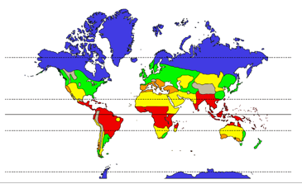

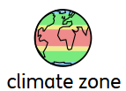
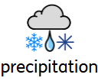

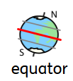
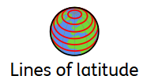
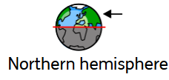
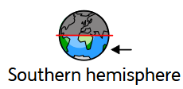
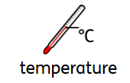


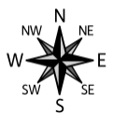
Topic: Crazy Climates | Year Four
Vocabulary
 | Long-term weather patterns
 | A part of the world where places have a similar climate (i.e. arid, Mediterranean, temperate, tropical, polar)
 | Rain, hail, fog, sleet and snow
 | Day-to-day temperature, wind, rainfall, etc.
 | The Equator is an imaginary circle around Earth. It divides Earth into two equal parts: the Northern Hemisphere and the Southern Hemisphere
 | Latitude lines are geographical coordinates that are used to specify the north and south sides of the Earth.
 | Northern half of the Earth. We live in the Northern Hemisphere
 | Southern half of the earth.
 | Temperature refers to the degree of hotness or coldness of an object or environment.
Sticky Knowledge
The Equator is an invisible line that runs around the centre of the Earth. The closer you live to the Equator, the hotter it is.
As the Earth is tilted on an axis, the Northern and Southern Hemispheres experience different types of weather at the same time of the year.
Climate is the average daily and seasonal weather patterns over a long period of time.
A temperate climate zone has mild summers and cool winters, with lots of rain spread across the year.
An arid climate zone is a dry area with very little rainfall, making it hard for most plants to grow
A Mediterranean climate zone has warm, dry summers and mild, wet winters.
A tropical climate zone is hot and humid all year round, with lots of rain and warm temperatures.
A polar climate zone is icy cold all year round, with long winters, freezing temperatures, and very little sunshine.
Skills I will use
 | Comparing I can notice and describe similarities and differences.
 | Map reading I can use a map to understand what a place looks like.
 | Compass points I can use a compass, which is a tool, to point out directions.

