Slide 1
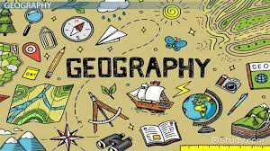
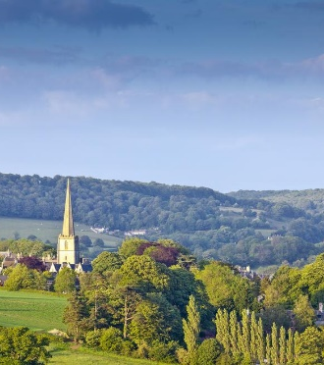
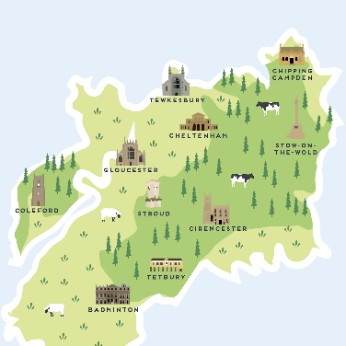
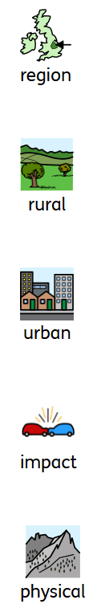


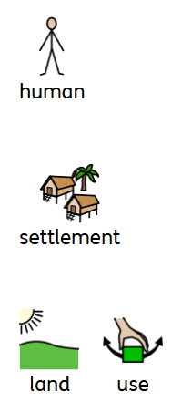




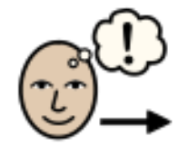
Topic: Glorious Gloucestershire | Year Three
Vocabulary
 | A large space or area.
 | Places that are not towns or cities. Often refers to the countryside.
 | Large towns and cities.
 | An effect.
 | Geographical features that occur naturally.
 | Geographical features that humans have made.
 | Places where people live.
 | What the land is used for.
 | Shops.
 | Factories where things are made.
 | Free time, time not spent working, at school or taking care of your needs.
 | When people travel for fun.
 | Where people work to make money.
 | Moving people or things from one place to another.
Sticky Knowledge
We are in the village of Nympsfield, the county of Gloucestershire and the country of England.
Human features are features of a place that are the result of human activity such as shops, farms, homes and roads.
Physical features are natural features such as mountains, rivers and seas.
Land can be used for lots of different things, and these uses have changed over time.
There used to be more land used for agriculture than there is now, and the amount of land used for industry has increased.
Skills I will use
 | Comparing I can notice and describe similarities and differences.
 | Map reading I can locate our area on an aerial map.
 | Predicting I can predict how my local area will change in the future.

