Slide 1
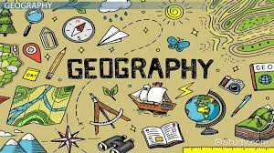
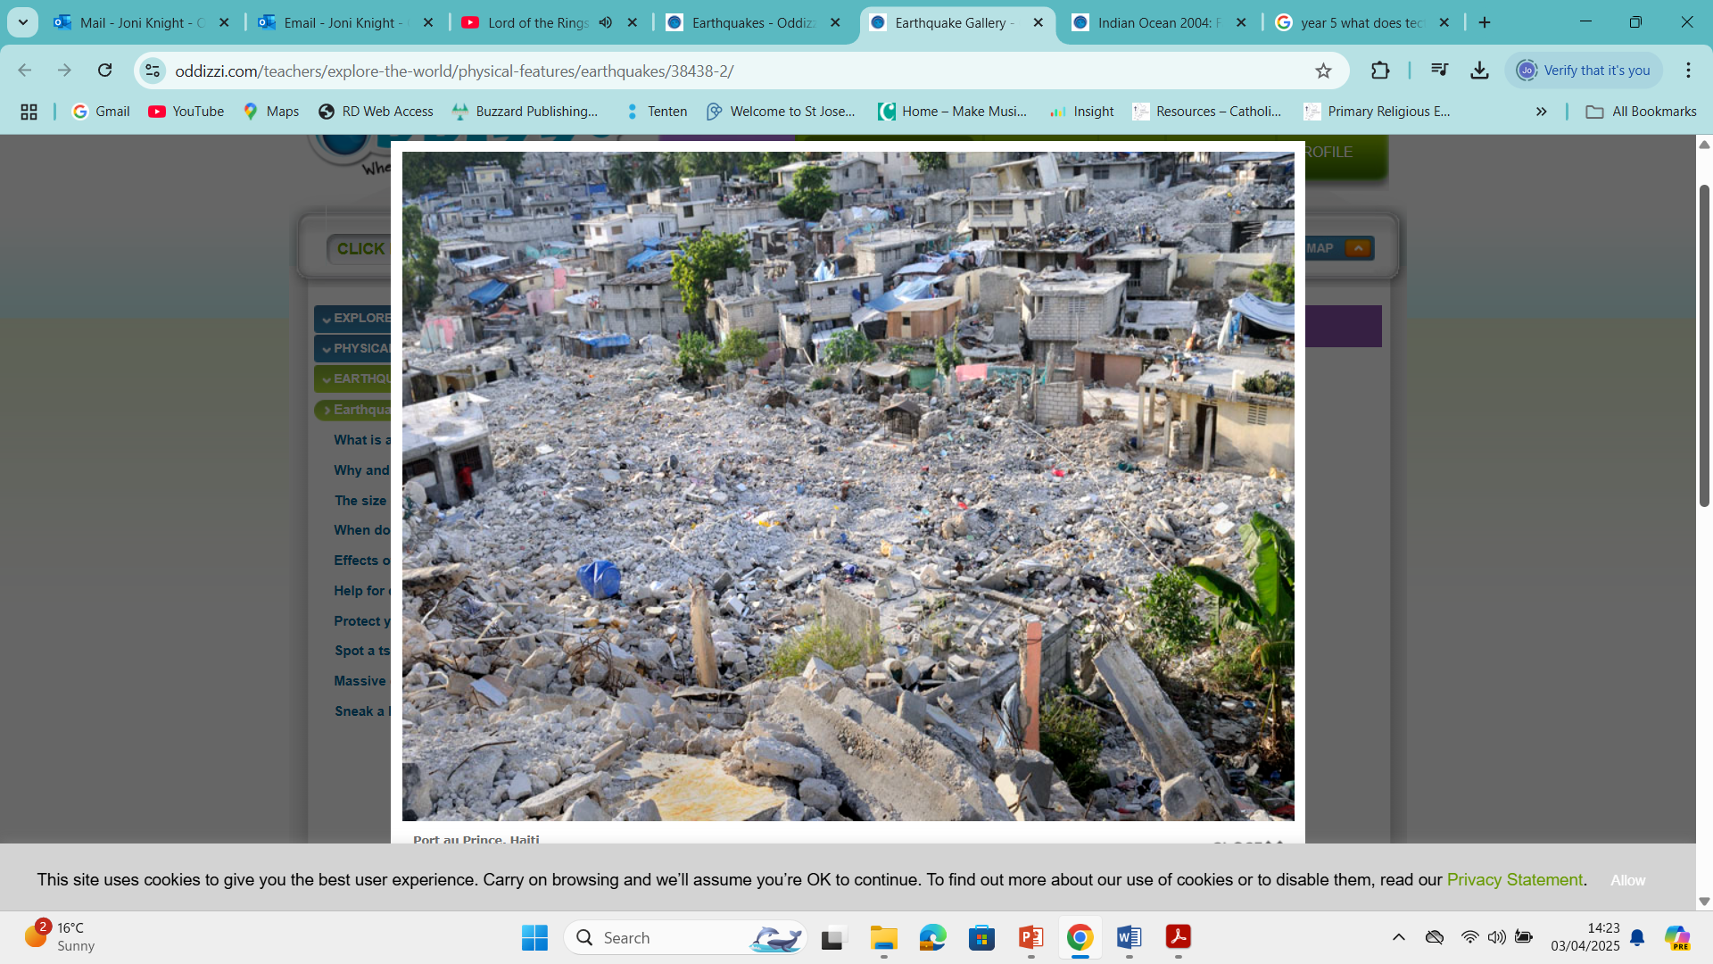
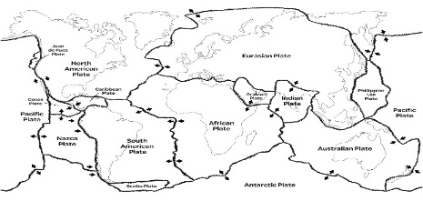

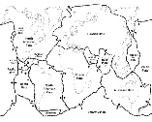














Topic: Smash, Shake, Crash! | Year Six
Vocabulary
 | Earthquake – a sudden shaking of the ground caused by movement inside the Earth.
 | Tectonic plates – huge pieces of the Earth’s crust that slowly move on top of the mantle.
 | Plate boundary – the place where two tectonic plates meet.
 | Epicentre – the point on the Earth’s surface directly above the focus, where shaking is usually strongest.
 | Magnitude – a measure of how powerful an earthquake is.
 | Seismic waves – waves of energy that travel through the Earth during an earthquake.
 | Ring of Fire – an area around the Pacific Ocean where many earthquakes and volcanoes occur.
 | Tsunami – a huge, powerful wave usually caused by an underwater earthquake.
 | Disaster – a sudden event that causes serious damage, injury or loss of life.
 | Damage – harm caused to buildings, land or people.
 | Aid – help given to people after a disaster, such as food, water or medical care.
 | Shelter – a safe place to stay after homes are damaged or destroyed.
 | Preparation – getting ready before an earthquake happens to stay safe.
Sticky Knowledge
Earthquakes occur when tectonic plates move and energy is suddenly released. They happen most often near plate boundaries, especially around the Pacific Ring of Fire. The movement usually happens at plate boundaries, where plates meet.
The point underground where an earthquake begins is called the focus and the epicentre is the point on the Earth’s surface where the shaking is felt most strongly.
Strong earthquakes can cause buildings to collapse and can lead to natural disasters such as tsunamis.
After an earthquake, people may need medical help, food, clean water and shelter. Emergency services and aid organisations help rescue people and provide support. Rebuilding homes and infrastructure can take many years.
People can prepare for earthquakes by strengthening buildings and practising safety drills. Emergency kits with food, water and first‑aid supplies help people stay safe.
Famous earthquakes have happened in places such as Japan, Haiti, Chile and Turkey.
Skills I will use
 | Understanding Physical Geography I can explain why earthquakes happen using knowledge of tectonic plates.
 | Locational Knowledge and Map Skills I can use maps, atlases and digital mapping to find where famous earthquakes have occurred.
 | Interpreting Geographical Evidence I can use information from sources to explain the impact of earthquakes and how people prepare for them.

