Slide 1
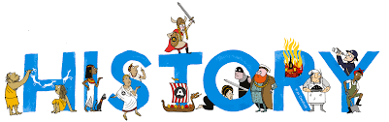
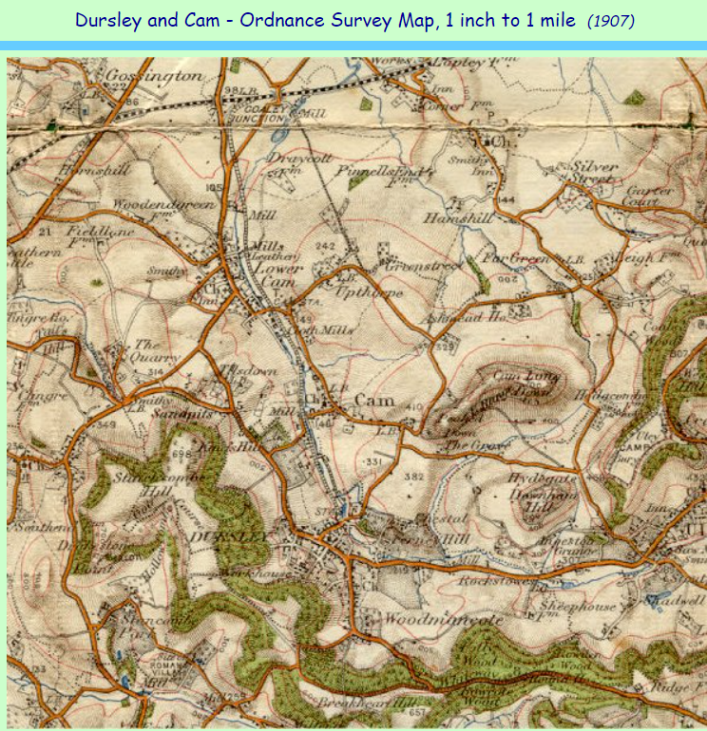
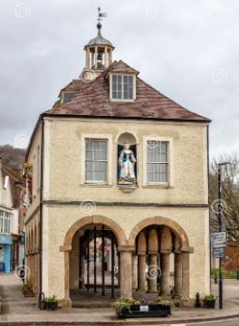
















Diverse Dursley | Year Five
Vocabulary
 | Industry This refers to how goods are made.
 | Social How people live and interact with each other.
 | Religious Religious culture are important in History as communities were built around places of worship.
 | Political Groups of people who make decisions together to make a better community.
 | Technological Over time, there have been big technological changes with how tools and devices are used.
 | Culture A way of life that included everything a group of people share, like language, food, beliefs and traditions.
 | Thematic map A type of map that focuses on a specific topic or theme across a geographic area
 | Spire A conical or pyramidal structure on top of a building, typically a church tower.
 | Education The passing on of knowledge in schools, normally from adults to children.
 | Sources A source is where information comes from.
 | Agriculture The practice of growing plants and raising animals to provide food, clothing and other useful things for people.
Sticky Knowledge
Dursley has grown over time.
St James’s church has changed over time.
Rednock building has changed over time.
Many people who lived in Dursley worked at Listers factory.
Listers made agricultural machinery.
Skills I will use
 | Compare: Look at the similarities and differences.
 | Look at evidence
 | Order timelines
 | Debate: I agree… I would like to disagree because..
 | Create theories

