Slide 1
Welcome to our
Parent Forum

Slide 2
What is the parent Forum?
The Parent Forum will be an informal meeting where parents are invited to be consulted on school issues, give their views and raise areas for discussion.

Slide 3
What is the Parent forum not
Parent governors – they sit on the Local Governing Committee and lead the strategic development of the school.
PTA – they are a separate legal entity who are registered as a charity, raising money to support different aspects of the children’s school life.

Slide 4
Terms of Reference….As a member of the parent forum I agree to:
Show respect to all members of this forum, by listening to and respecting a diverse range of opinions
Allowing everyone the opportunity to speak
Stick to agreed timescales for discussion of topics
Maintain confidentiality by not mentioning the names of individual members of the community
Avoid discussing individual circumstances. These issues will be directed via the school’s communication procedure instead

Slide 5

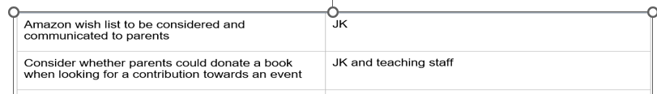

Slide 6
St Joseph’s Communication about School trips

Slide 7
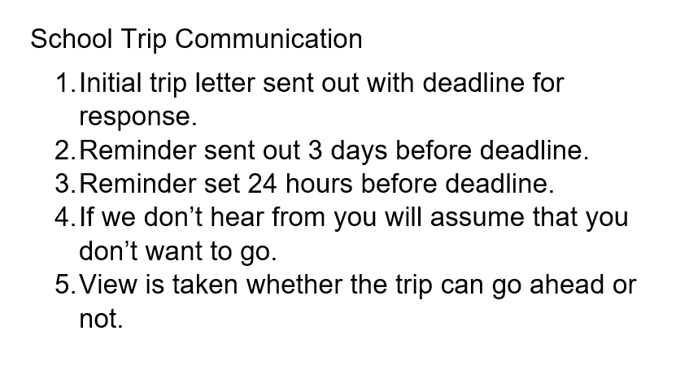

Slide 8
Behaviour Policy 2026

Slide 9
School Uniform

Slide 10
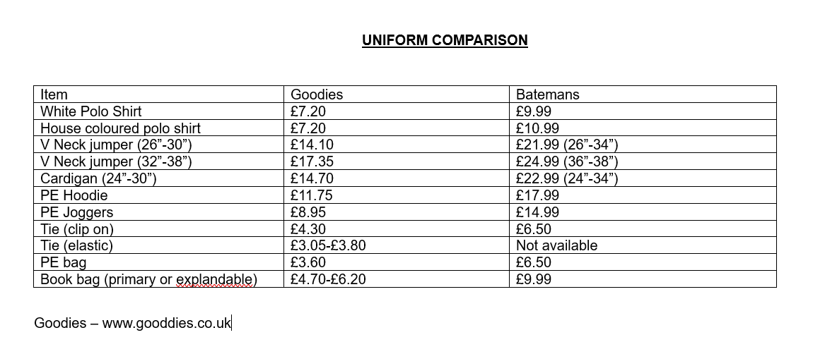

Slide 11
Other topics that you would like to discuss in the future?

