Slide 1



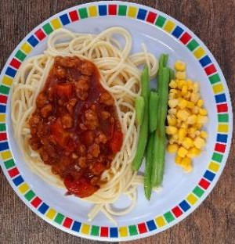


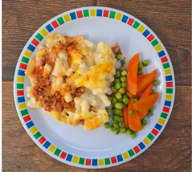








Tomato Pasta
Sausage Roll with Potato Wedges & Tomato Ketchup
Roast Chicken with Stuffing, Roast Potatoes and Gravy
Spaghetti Bolognese
Fish Fingers with Chips &
Tomato Ketchup
Cheese and Pepper Whirl with Herby Rice
Soya Mince Pasta Bake
Vegan Sausages with Roast Potatoes and Gravy
Coconut Curry with Rice
Cheese and Broccoli Frittata with Chips & Tomato Ketchup
Oaty Cookie
Orange Drizzle Cake
Ice Cream with Fresh Fruit
Carrot Cake with Custard
Fruit Jelly with Peaches

Slide 2
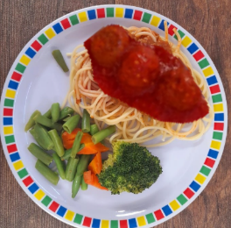
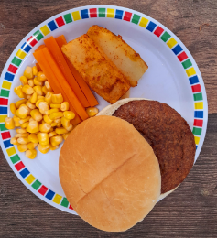


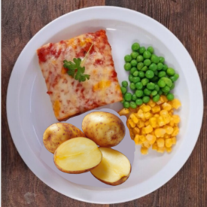
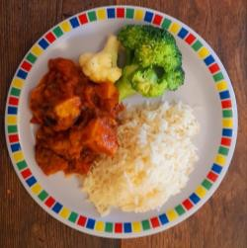

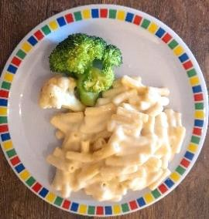


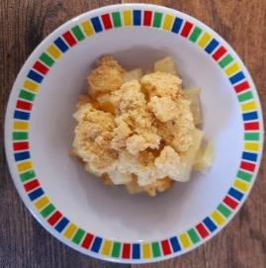
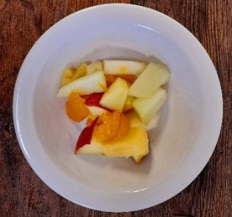


Vegan Meatballs in Tomato Sauce with Spaghetti
Beef Burger with Cheese in a Bun with Potato Wedges & Tomato Ketchup
Roast Gammon with Roast Potatoes and Gravy
Peri-Peri Chicken with Herby Rice, Sweetcorn & Cucumber Salsa
Fish Fingers with Chips & Tomato Ketchup
Cheese and Tomato Pizza with Herby New Potatoes
Sweet Potato Curry with Rice
Roast Quorn with Roast Potatoes and Gravy
Macaroni Cheese
Vegan Sausage with Chips & Tomato Ketchup
Golden Syrup Snap Biscuit
Peach Crumble with Custard
Fruit Medley
Chocolate Brownie
Orange & Lemon Shortbread

Slide 3

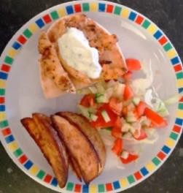
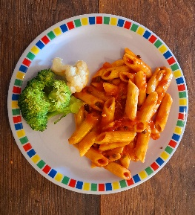


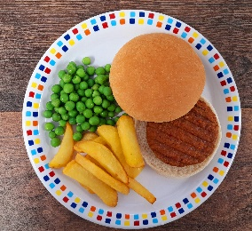
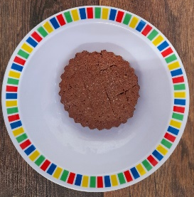



Summer Pizza with Herby New Potatoes
Spaghetti Meatballs
Roast Pork with Roast
Potatoes and Gravy
Greek Chicken Pitta with Rice and Tzatziki
Fish Fingers with Chips & Tomato Ketchup
Tomato Pasta Bake
Vegan Burger in a bun with Potato Wedges & Tomato Ketchup
Vegetable Loaf with Roast Potatoes and Gravy
Vegan Bolognese with Pasta
Cheese and Bean Pasty with Chips & Tomato Ketchup
Chocolate Shortbread
Apple Pie with Custard
Iced Vanilla Sponge
Summer Lemon Cake
Ice Cream with Peaches

